Slide 1
Social
Studies
Writing
Spelling
Welcome to Curriculum Night
Third Grade
Reading
Science
Math

Slide 2
The Third grade team
Mrs. Rubis has been teaching for 28 years. The first 16 years of her career was spent in first grade. She absolutely LOVES teaching third graders! She received both her undergraduate and graduate degrees from MSU. She has two sons – Joshua is in 12th grade and Jacob is in 8th grade. In her spare time she enjoys cooking, gardening, golfing, and watching her boys play baseball.
Mrs. Bronoel spent her first 13 years at Rogers teaching fourth grade. She is very excited to be teaching third grade for the first time. She received her undergraduate and graduate degrees from the U of M. Her sons are in 1st and 4th grade here at Rogers. She loves visiting museums with her family, watching baseball, and doing crossword puzzles.
Ms. Stokes is so excited to join the Rogers' family and to have an awesome year teaching third graders! In the past, she has taught third grade and kindergarten on the East Coast. She received both her undergraduate and graduate degrees from Howard University. She is very close with her mom, dad, and sister, Kelley, who also live in Metro Detroit. When she is not teaching she loves to bake, swim, read, and play with her dog, Holly.

Slide 3

Parent-Teacher Teamwork
We strive to create a calm, caring and successful learning environment.
You are your child’s most important teacher and role model.
We strongly encourage children to take on responsibilities which will promote their independence. We need to work together to achieve this goal.
Please share information that will impact your child’s performance in school.

Slide 4
Independence
Third grade is a big year for transitions, and we will be working to teach your child independence and responsibility. Please encourage your child to put the Home Link in his/her folder after asking you to review it for accuracy.
If your child mistakenly leaves homework or items (gym shoes, library books, etc.) at home, please take advantage of the learning opportunity that your child will encounter at school by accepting the consequences of his/her actions.

Slide 5
Student Planners
Students will record homework assignments and reminders in their planners on a daily basis.
Please check your child’s planner each night.
Planners and the Back and Forth folder need to be brought to school each day.

Slide 6
Homework Expectations
It is every student’s responsibility to complete homework assignments.
Parents will be notified if missing homework becomes a pattern.
Students who do not complete and return their homework may be benched from afternoon recess.
Student’s report card will reflect homework completion.

Slide 7
HOMEWORK
Reading: RAH Program Please have your child read for a minimum of 15 minutes per night and record on the weekly calendar slip. Slips are returned every Monday and a new slip will go home in the blue folders. Students should be taking AR quizzes on books they are reading for RAH.
Math: Home Links/math assignments, math facts and End of Unit study guides. Periodically we will be sending home either a replacement math homework assignment or on in addition to the home link. These additional assignments will have children explaining their thinking as s/he solved the problem.
Spelling: Look for words to come home every Friday. There will typically be an activity to complete and return. Test day is the following Friday.
Science & Social Studies: Unit projects or vocabulary assignments may accompany some units. Study guides will be sent home prior to each unit test.

Slide 8



It is our goal to create an environment where all children can learn and grow academically and socially. In order for this to occur the students must demonstrate behaviors that will not interfere with learning. Students are expected to be safe, respectful and responsible each and every day. This requires making good choices with our words and actions whether we are in the classroom or on the playground.
Parents will be notified of behavior problems if they become a persistent problem or are occurring on a daily basis.
Weekly Behavior Progress Reports will be sent home for the first six weeks of school starting on September 21st. These reports will keep you informed as well as help students reflect on their behavior and set goals for improvement.

Slide 9
Reading Program
Lucy Calkins Reader’s Workshop
Partner Reading
Novels: Whole Class and Small Groups
Scholastic News – Thank you PTA!
D.E.A.R. and Read-Alouds
Reading A-Z Fluency
Ongoing Reading Assessment:
  Fountas and Pinnell – Guided Reading Level
  DIBELS
  Accelerated Reader Program

Slide 10

Reading Units
Fiction
Non-Fiction - there will be 3 months (not consecutive) devoted to this unit
Mystery
Poetry
Humor
Folktales/Myths

Slide 11
What Research Says…
“Reading Comprehension test scores are more influenced by students’ amount of engaged reading time than any other single factor.”
Stephen Krashen 2004
Achievement Percentile | Minutes of Reading Per Day | Words Per Year
90th | 40.4 | 2,357,000
50th | 12.9 | 601,000
10th | 1.6 | 51,000

Slide 12

Writing Program
Emphasis on The Writing Process using
Writer’s Workshop based on Lucy Calkins:
  Prewriting
  Drafting
  Revising
  Proofreading (editing)
  Publishing
  The process of writing is as important as the product; therefore, the emphasis of writing lessons will be on the process itself and the students will not publish all pieces.

Slide 13

Forms of Writing
Sentences & Paragraphs
Personal Narratives
Informational
Opinion (Persuasive Letters and Essays)
Poetry
Fiction
Research
Cross-curricular writing: math, science, social studies

Slide 14
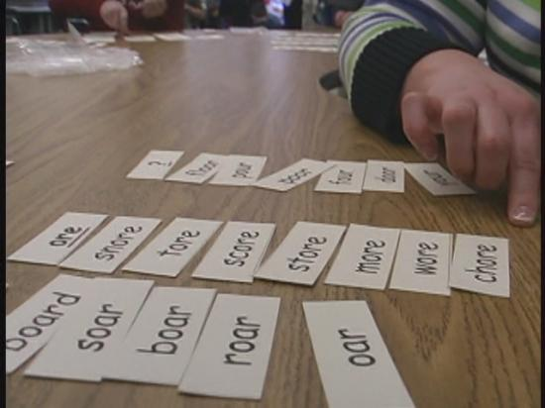

Words Their Way
Word study for phonics, vocabulary, & spelling instruction. The program focuses on patterns and rules - not memorization.
Differentiated instruction in small groups. Groups are based on pre-test.
Weekly word lists, sorts, and activities
Spelling test every Friday.

Slide 15
Mathematics
Everyday Mathematics
  We now have the most current edition of Everyday Math which is aligned to the Common Core Standards.
  Children are involved in sharing ideas through discussions focused on “why.” Often students will be asked to write in words how they solved problems and why they chose certain methods to get to an answer.
  Troll Math – A way to practice our math facts and
  promote fact fluency.

Slide 16
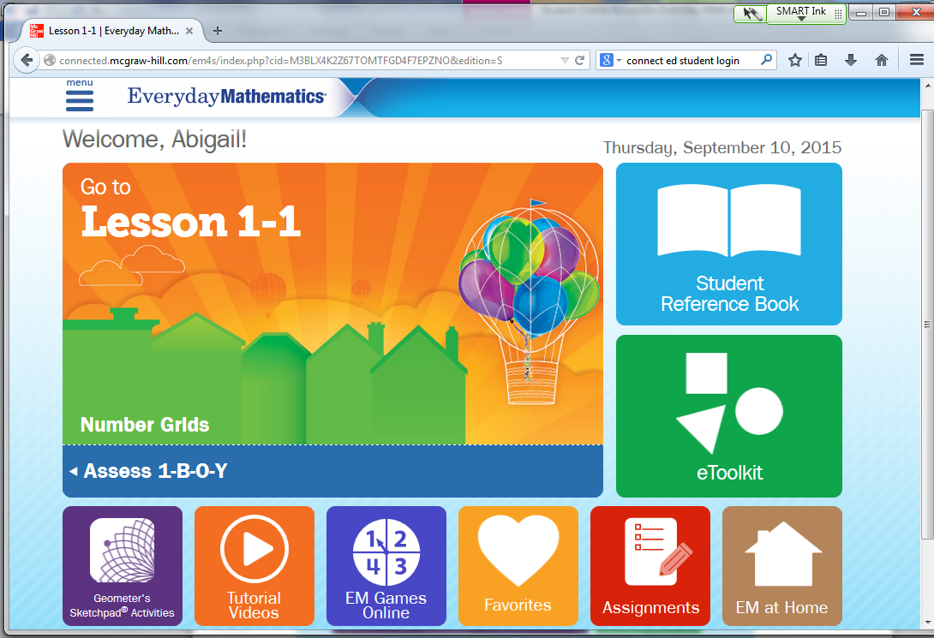
Mathematics
Everyday Mathematics Online Resources
The new version of EDM comes with great online resources that can be accessed at home.
After this presentation please pick up your child’s Homelink book on which you’ll find their online login information.
Support Videos
Copies of Homelinks
Reference Book
Games

Slide 17
Third Grade Math Units
Unit 1: Math Tools, Time and Multiplication
Unit 2: Number Stories and Arrays
Unit 3: Operations
Unit 4: Measurement and Geometry
Unit 5: Fractions and Multiplication Strategies
Unit 6: More Operations
Unit 7: Fractions
Unit 8: Multiplication and Division
Unit 9: Multi-digit Operations

Slide 18
Science Units
Force and Motion
Animal Habitats and Adaptations
Light Energy and Shadows
Sound Energy
Weather and Climate
Scientific Process

Slide 19
Social Studies Units
Michigan (Geography, History, Industry, Economy, Government, Public Issues)
The History of Early Detroit
Core Democratic Values

Slide 20
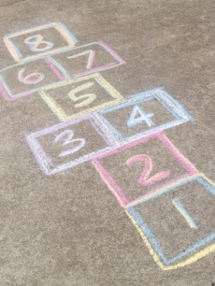
Recess
Recess breaks are important!
Individual classroom teachers will determine recess/break based on student needs.
Recess is a time for your child to release energy, strengthen large motor skills, and to socialize and problem solve when playing.

Slide 21
Children Needing To Miss School
If students are absent for one or two days, they may get the work they missed when they return.
If students are absent for more than two days, assignments may be picked up on the third day.
If you are planning to take your child on vacation and will be gone for one week or more, all the assignments your child missed will be placed in a folder. S/He may have double the time they were gone to complete the work. For example, if you are gone for one week your child will have two weeks to make up the missed work.

Slide 22

Third grade students will take the English Language Arts (ELA) and math assessments, which will include multiple choice questions and questions that require open-ended responses. The test is administered online. Teachers will continue to provide opportunities for students to improve their computer skills (typing, using a mouse, operating different tools and scroll bars, etc.). Please keep in mind that this test is just a snapshot in time of how your child is performing.

Slide 23

REPORT CARDS
Imagine a quarterly review of your job performance, the results of which are never shared with you by your boss. It would be very disappointing not to receive any feedback for all your effort. A report card is a quarterly review of your child's progress and they are as curious as you to know how they've done after 10 weeks of hard work and study. Therefore, please make a concerted effort to sit down with your child and review his/her report card. Be sure to point out the areas in which s/he excels, has made improvement and still needs to keep trying. Doing so lets your child know that you are concerned about him/her and that his/her success is important to you.

Slide 24
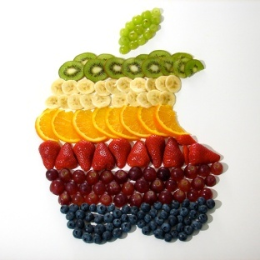
SNACKS
Students may bring a healthy morning and afternoon snack.
Great snack choices are: fruit, veggies, crackers, raisins, dried cereal, cheese, yogurt
Students are also not permitted to share food with other students during snack or lunch time. Please remind them of this.
***Please see your child’s teacher for allergy information.

Slide 25
Staying Healthy
Together we can help students to stay healthy by:
reminding them to sneeze/cough into the inside of their elbow
reminding them to wash hands often (soap, warm water)
reminding them not to share food/drinks
If your child is sick or has a fever, please keep him/her
away from school and others.
We appreciate donations of tissues, Lysol wipes,
& hand sanitizer – THANK YOU! ☺

Slide 26
HELPING OUT
Troll Math - We are in need of parents to help with our troll math program. Each classroom needs one parent is to check the weekly facts test and another parent is needed to glue gems on the student caps.
Book Order Volunteer - A parent is needed to help oversee and organize this activity.
Classroom Parties – Parents are needed to plan the parties and also to donate the needed food, drink and supplies. Sign up sheets are in the classrooms.
PARENT VOLUNTEERS MUST FILL OUT A BACKGROUND CHECK FORM
Whether you are in working in the classroom, driving on a field trip, reading to students or joining the fun at one of the class parties the form must be filled out. Paper copies of the form will no longer be accepted. All applications must be submitted electronically through the BSD website. Click on the Parent tab at the top and scroll to the bottom and click on the link under Volunteer Release Form.

Slide 27

Sign Up
Back in each classroom are sheets to sign up for attendance this evening along with party planning and donations.
There is also a pink heart on your child’s desk. Please take a moment to write a note to your child and leave it on the desk.

Slide 28

Your attendance tonight
is greatly appreciated!

