Slide 1
Round Up for
TK and K
2022-2023
Burton Elementary

Slide 2
Welcome to 2022-2023 School Year
The information included in this powerpoint is subject to change due to changing regulations
from the CDC and
the State of Michigan.

Slide 3
Burton Elementary
We will have 1 Transitional Kindergarten Classroom
We will have 3 Kindergarten Classrooms
Our students will also have Art taught by Mrs. Jakuc, PE taught by Mrs. Grabowski, Media/Library taught by Mrs. Smith, and Music taught by Mrs. Manuel.

Slide 4
Class Placement
Who is my teacher?
You will receive your child’s placement in early August. The teachers will reach out to you with a welcome note to your child.
All of our TK and Kindergarten teachers work closely and share many activities.
We are one big happy family!
It may be necessary to adjust your child’s class assignment as we get to know the individual strengths and needs of your child. We normally hear from the preschool teachers and sometimes visit preschools to see your children in action in their preschool environment. We were happy to be able to follow our typical protocol this year with some preschools but not with all.

Slide 5
A Typical day in the life at Burton
We will keep you informed if anything changes
Students will arrive at their designated doors and wait for their teacher to come and collect them. Parents should say goodbye at the door and not enter the building. The teachers and helpers will make sure everyone gets to their classroom and assist in unpacking. Each child will have a locker to themselves with the exception of twins sharing a locker. The teachers will show them how to open the locker (no combination locks until Middle School) and how to hang up their belongings. They will then enter the classroom to begin the day.
Here is a sample of a typical day:
Morning Meeting and announcements, Pledge of Allegiance, lunch count for purchasing(free at this time) lunch.
Carpet time - welcoming the group, calendar time, read alouds, discussion of day’s events and expectations
Morning work time, break, special (art, music, PE or media)
Lunch in the classroom or gym 11:45-12:15 with Recess 12:15-12:45
Physical Break/activity- outdoors if the weather permits
Rest time- on mats in the classroom to rest their minds and bodies
Afternoon work time - and possibly a special class
Continuation of work time - pack up and dismissal
Miss Posey and Mrs. Chmiel doors- Plaza by the clock called the Plaza doors
Mrs. Martin doors- by the tubes on the playground called the Tube doors
Ms. Williams door- the back doors by the track called the Fifth grade doors.

Slide 6
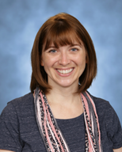
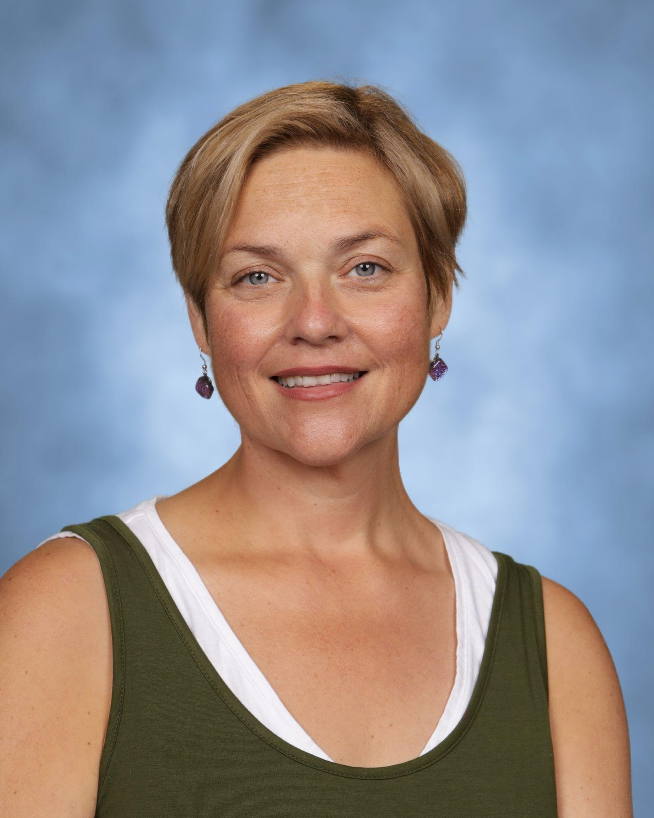
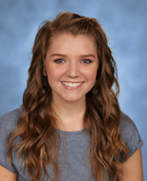
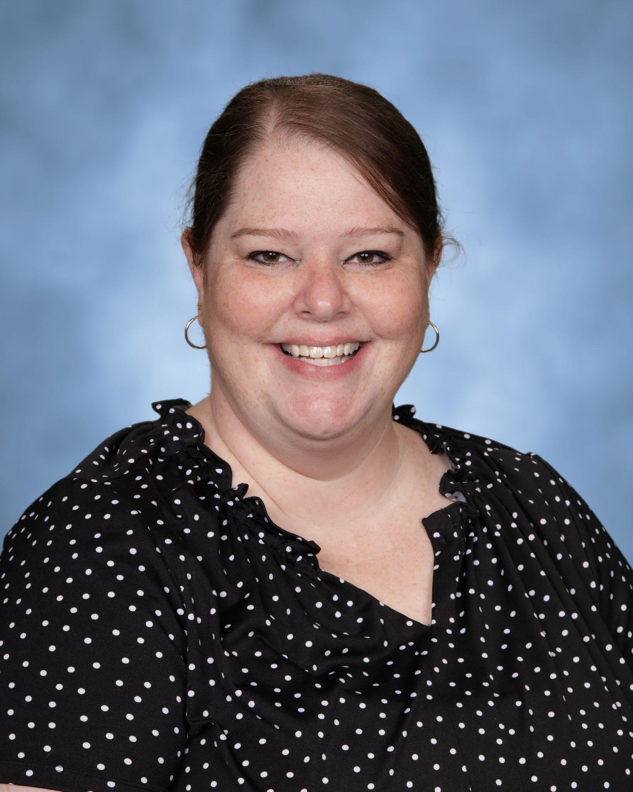
Meet The TK and K Teachers
Miss Posey, Mrs. Martin, Mrs Chmiel, and
Ms. Williams

Slide 7
Our students will have at least one special class from each subject area each week.
Art is taught by Mrs. Jakuc, PE taught by Mrs. Grabowski, Media/Library taught by Mrs. Smith, and Music taught by Mrs. Manuel.

Slide 8
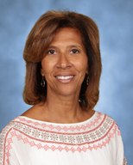
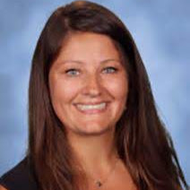
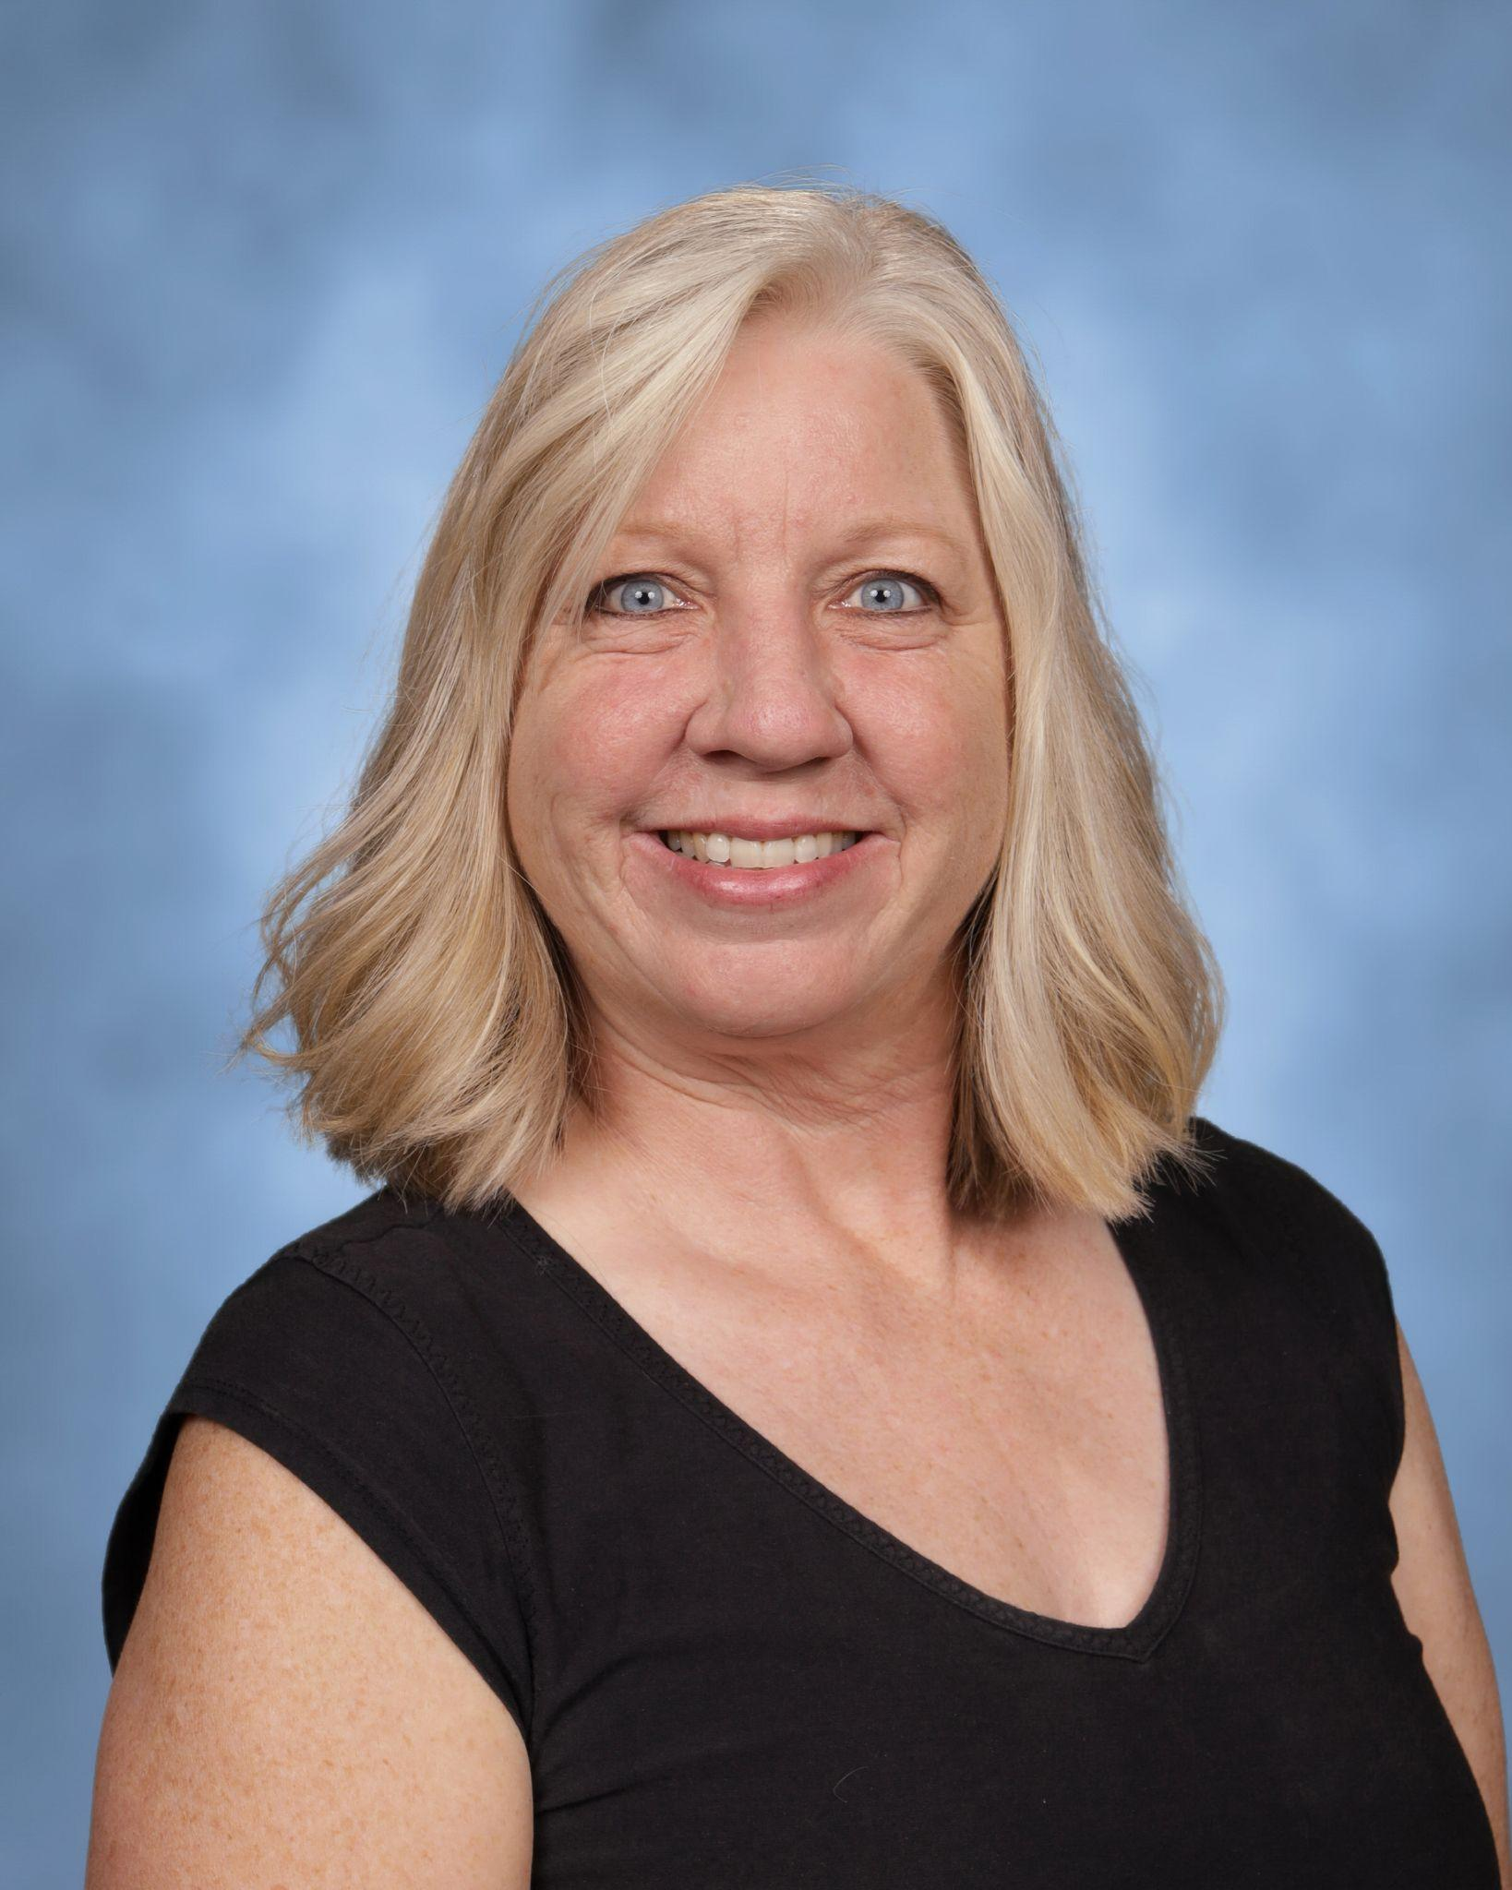
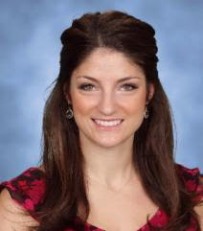
Meet the Specialists
Music, Media, Art and PE
Mrs. Manuel, Mrs. Smith, Mrs.Jakuc
and
Mrs. Grabowski

Slide 9
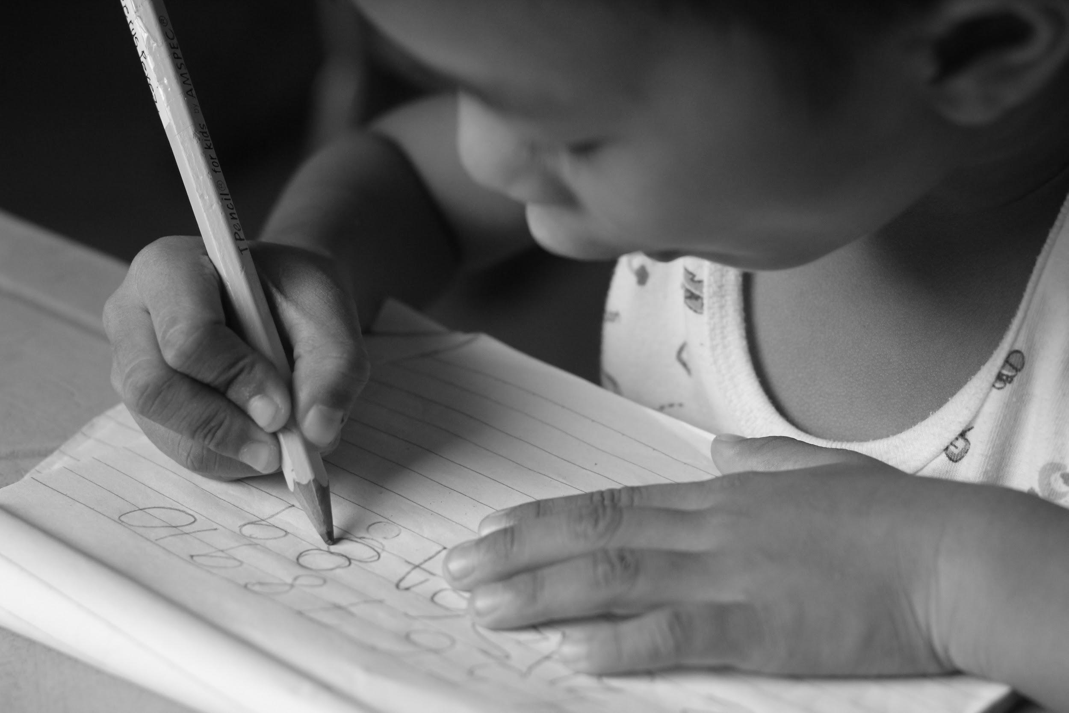
Handwriting
TK and K students will also learn about handwriting. We use a program called Learning without Tears. This covers both the correct formation of letters and numbers.

Slide 10
COMMUNICATION
Parent communication is very important to us. We use a team approach between home and school. Teachers will send emails, contact you by phone or see you at dismissal. You are always welcome to contact teachers through voicemail or email. Please remember that during the day the teachers are teaching and cannot return calls or emails until the end of the day. They need to give your children all of their attention during the day.

Slide 11
LUNCH AT BURTON
We will begin the year by having lunch in the classroom and hopefully move into the gym/cafe as the restrictions change. This summer, please practice at home with a lunch box and lunch items. Your child will feel much more confident if they can open everything themselves. Be mindful of the containers you use. We are a Nut Sensitive building, so please read all labels carefully, no nut products or items from a facility that also processes any kind of nuts.
Thank you.

Slide 12
Curriculum
Life Skills
Works and plays well with others
Practices self control
Follows Directions
Develops Independence
Shows responsibility
Resolves problems effectively
SEL
Reading
Names upper and lower case letters
Identifies beginning sounds
Sight words
Rhyming
Phonemic awareness
Retell stories
narrative/informational text

Slide 13
Writing
Write personal narrative using words and pictures
Write how-to and persuasive pieces
Form letters correctly
Math
Number sense
Patterns
Shapes
Read and write to 30
Solve simple +/- problems
Count to 100
Science
Building a sense of wonder in the works around us
Force and motions
Weather
Plants and animals
Social Studies
Navigating our school
Working as a team
My place in time

Slide 14
Teaching Modes
Differentiation
Targeted skill work based on assessments and needs
PLAY
Shapes the brain, fosters empathy, adaptability, complex thinking and emotional regulation
Fantasy/ imagination
Constructive
Rule based games
Rough and Tumble

Slide 15
Growth Mindset
Flexibility
Persistence
Empathy
Resilience
Optimism
Mindfulness
Self-awareness
Self-regulation
Empathy
Problem solving

Slide 16
First Day of School
We begin the year on Monday, August 29, 2022. Both August 29 and August 30 will be half days of school for TK and K only. Dismissal for those days will be at 11:20 am. The afternoons of these days will be used for assessments by appointment. At that time, the teachers will be meeting with the children in small groups to assess their beginning skills. The Speech Pathologist and Occupational Therapist will also play some games with the children to assess their skills.

Slide 17
Childcare
The HW Rec Center provides before school care and also after school latchkey.

Slide 18
Curriculum Nights
In person
We are planning to have in person curriculum night in June for Kindergarten and in August for TK.
The K curriculum night is Thursday, June 23rd at 6:00 pm.
The TK curriculum night will be Thursday, August 25th at 6:00 pm.
https://vm.tiktok.com/ZTdpgh371/l

Slide 19
Picture day
Our picture day will be on
Wednesday,September 7, 2022
At this time your child’s lunch card/library card will be made as well as school photos.

Slide 20
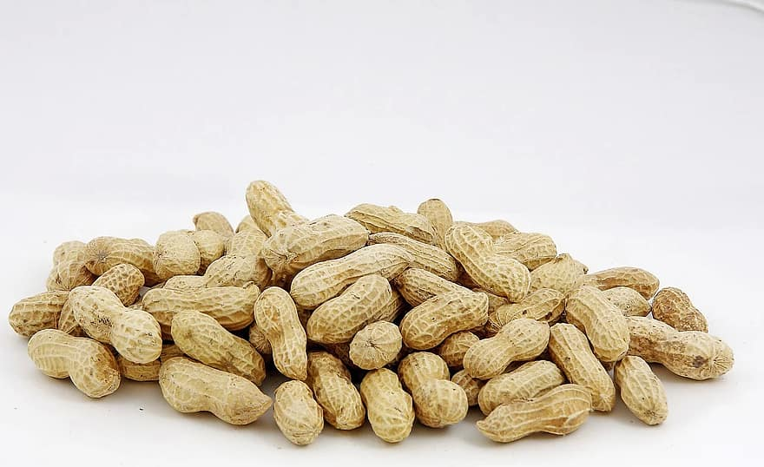
Allergies
If your child has any allergies that require an EpiPen or medical attention please contact the Burton Office for medical forms and/or more information about our procedures. Burton is a Nut Sensitive building. No food items brought into the building can contain nuts or manufactured in a facility that may have traces of nuts.

Slide 21
Links for information needed for the
first day of school
Vision: Michigan Law (Public Health Code, Act 368, and Michigan School
Code, Act 291) requires a vision screening for kindergarten entrance.
Vision screening done in preschool, by a health department technician or doctor’s office.
Oakland County Health Division offers free vision screening for
County residents. More information can be found here: https://www.oakgov.com/health/services/Pages/Vision-Testing.aspx
Immunizations: Children need to be up to date on immunizations prior to the first day of school. You can find the list of recommended vaccines located on Oakland County's Website here: https://www.oakgov.com/health/services/disease-prevention/immunizations/Pages/cost-schedule.aspx
Waivers: If your child is unable to receive a vaccination you will need to provide a waiver. More information can be found here: https://www.oakgov.com/health/services/disease-prevention/immunizations/Pages/rule-change.aspx

Slide 22
Who to contact for questions?
She can always be reached at the information below
Maribeth Krehbiel
Maribeth.Krehbiel@berkleyschools.org
234-837-8600

