Slide 1
Transitional Kindergarten
& Kindergarten
Information Night - 2023

Slide 2
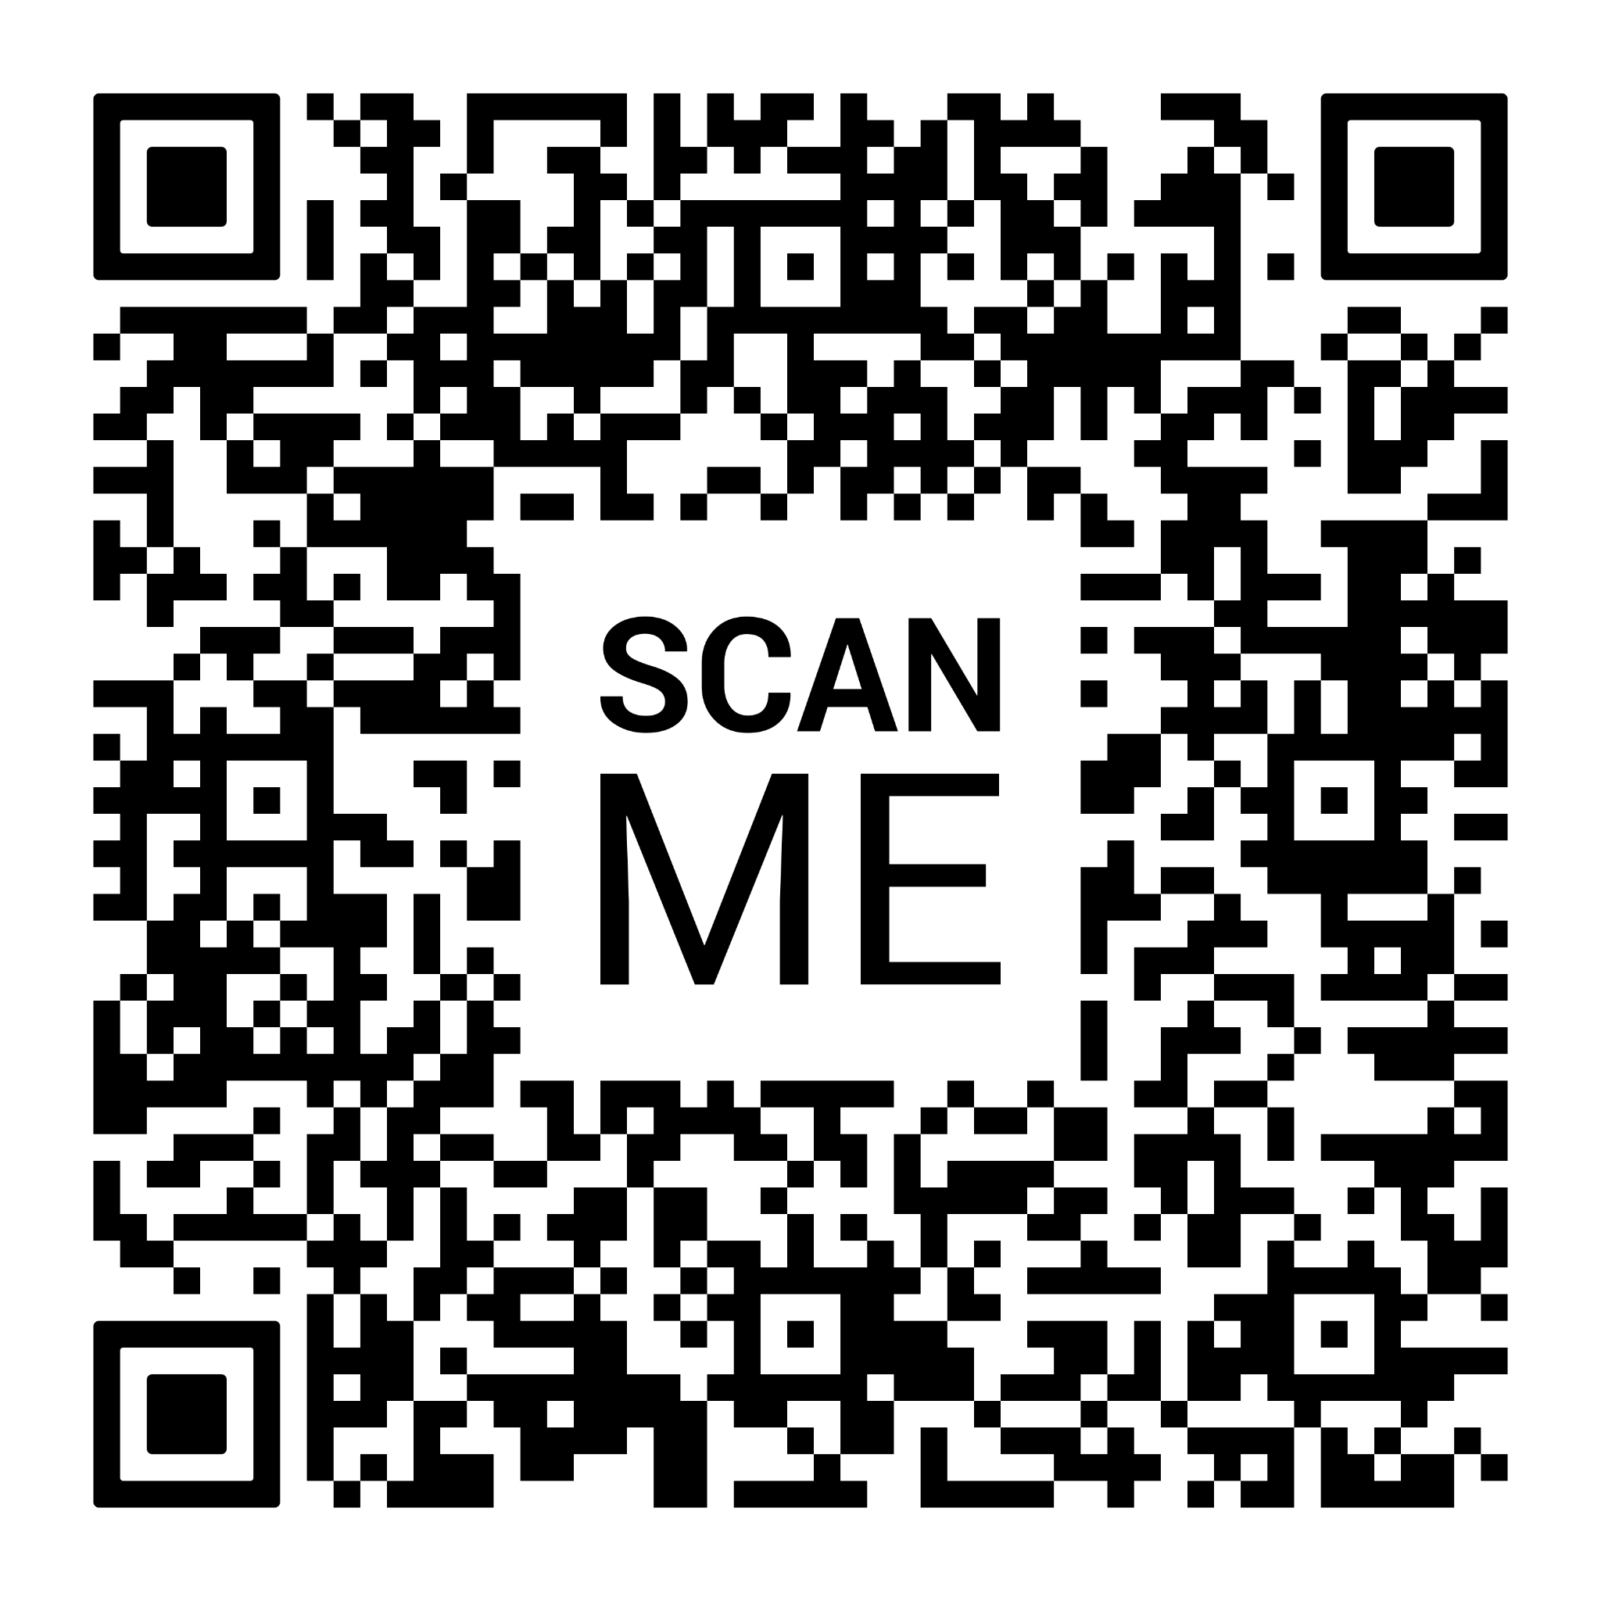
Tonight’s Agenda
Welcome - please fill out the attendance sheet
Handouts
Presentation
Questions
Tour of the building
School staff available for questions

Slide 3
Principal’s Welcome
Welcome to Burton Elementary School
We are so pleased you will be joining us for the fall of 2023. Our school is a warm and inviting place to learn and grow.
Here are a few faces that will become familiar soon.

Slide 4
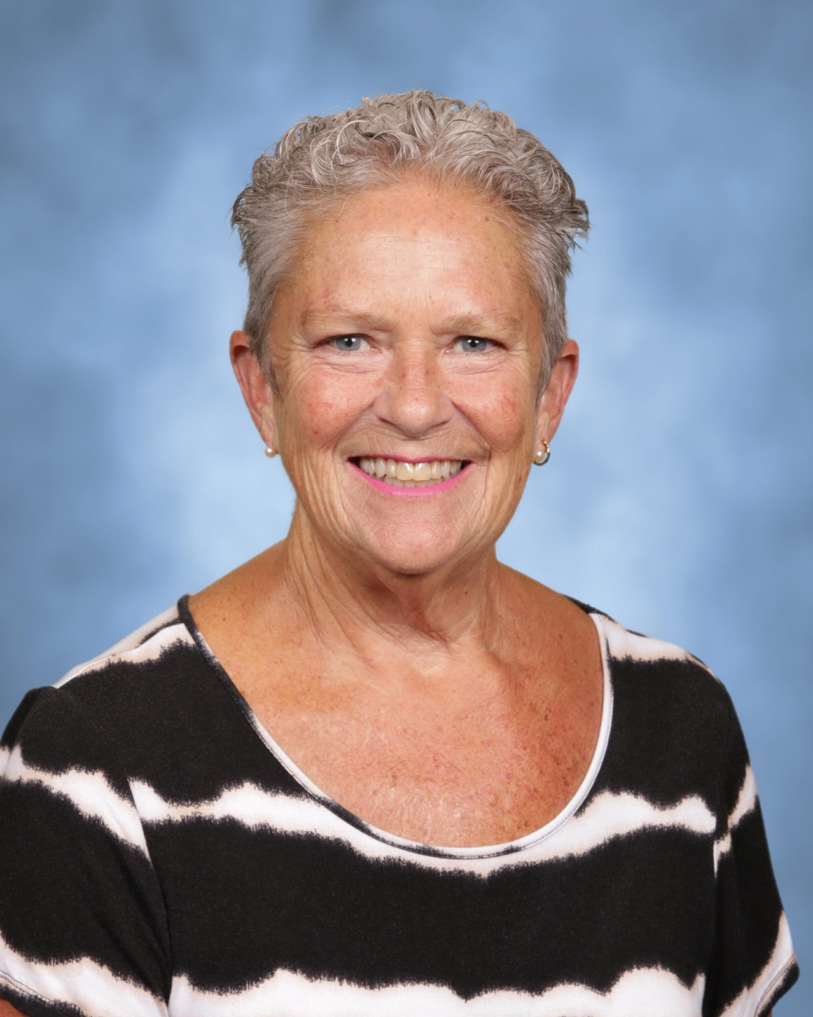
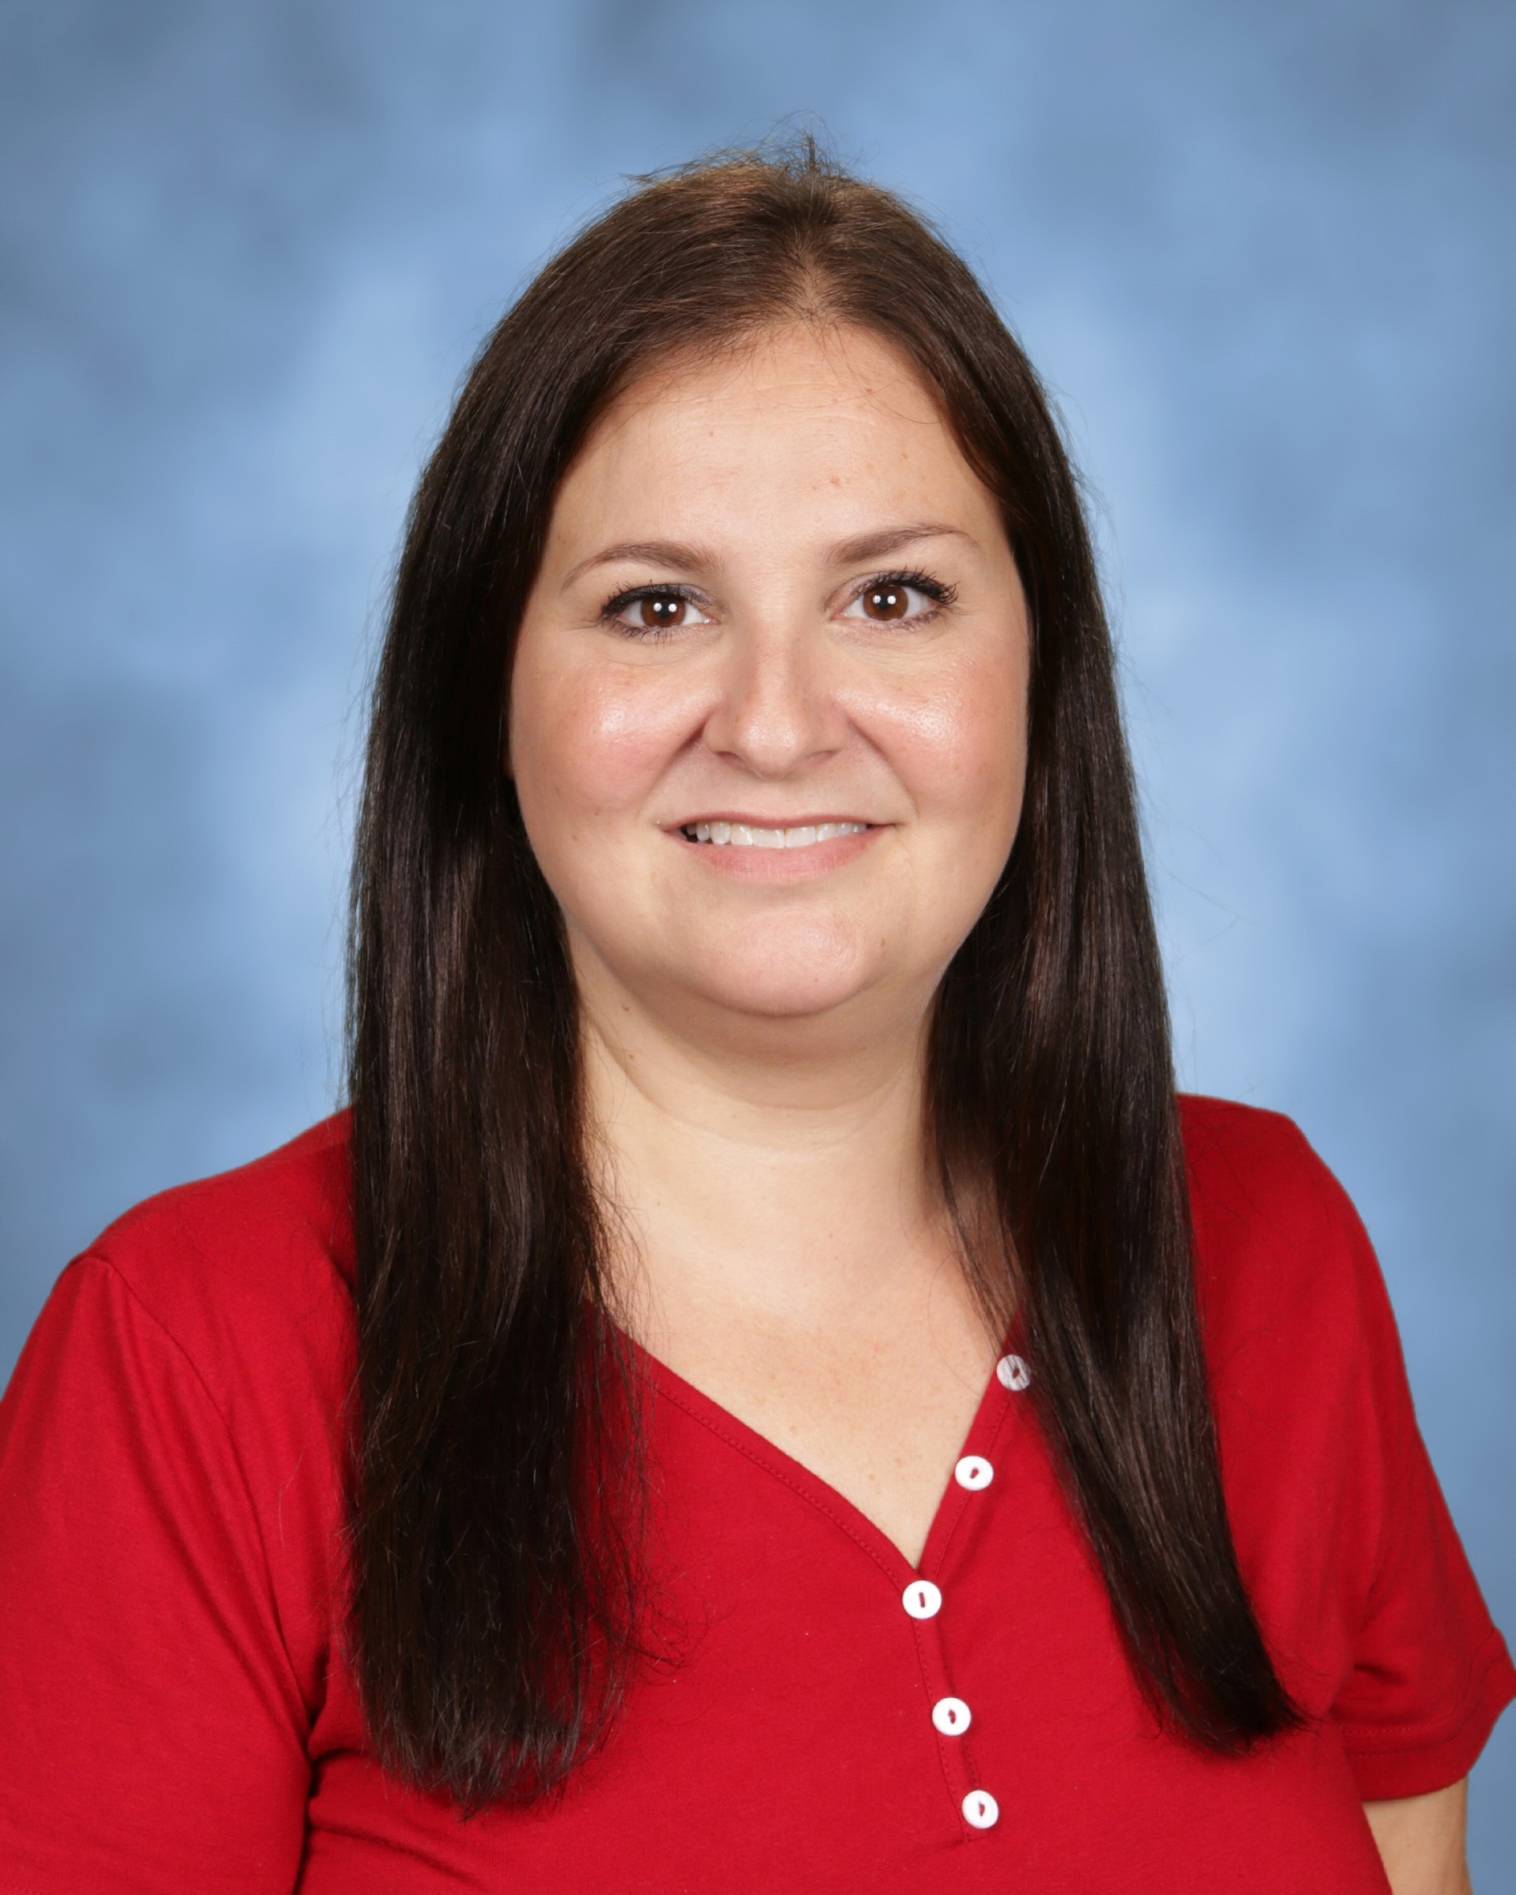
Our Office Staff
Miss Patti Miss Erika
Miss Patti Miss Erika

Slide 5
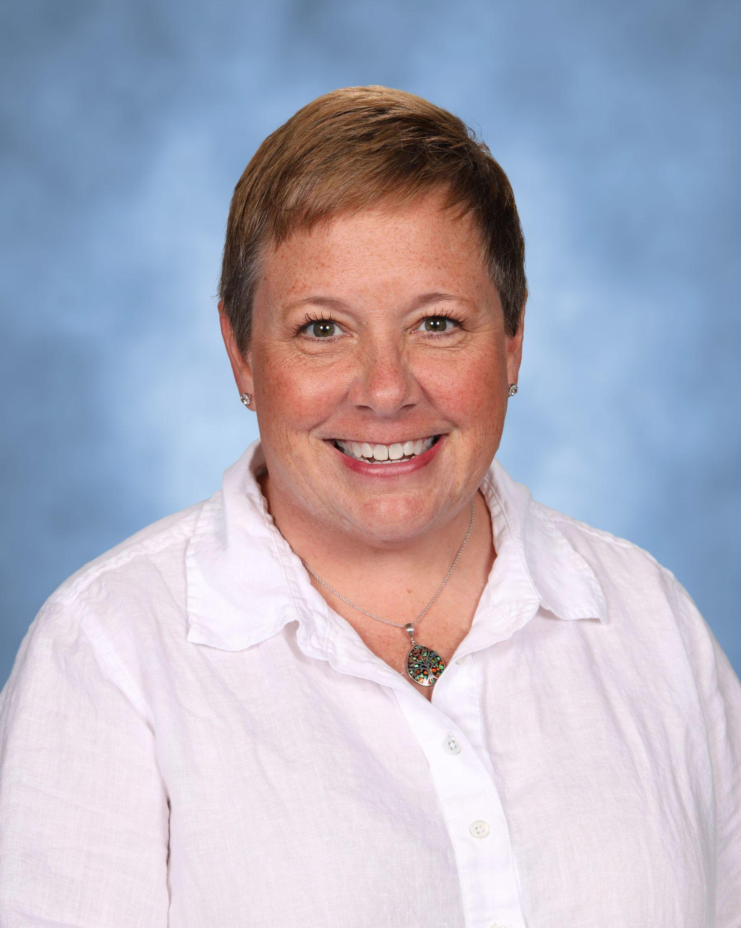
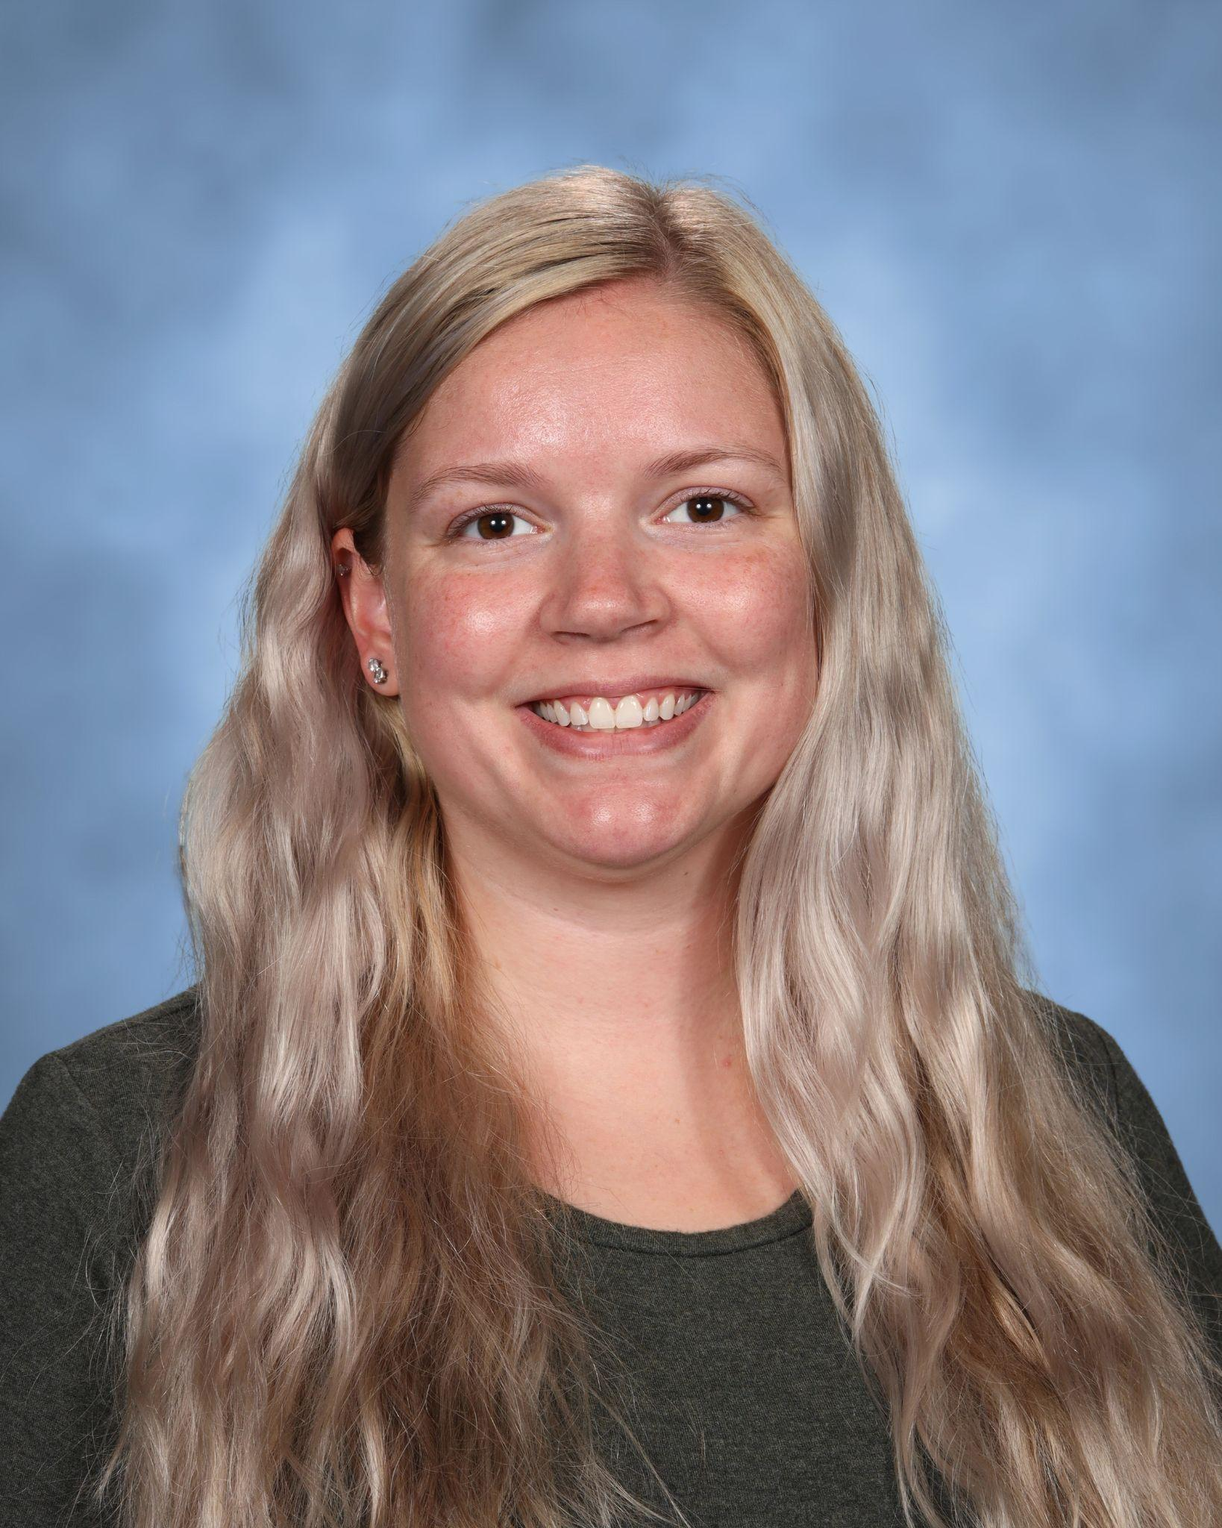
Burton’s Social Workers
Mrs. Cain
Miss Ball

Slide 6
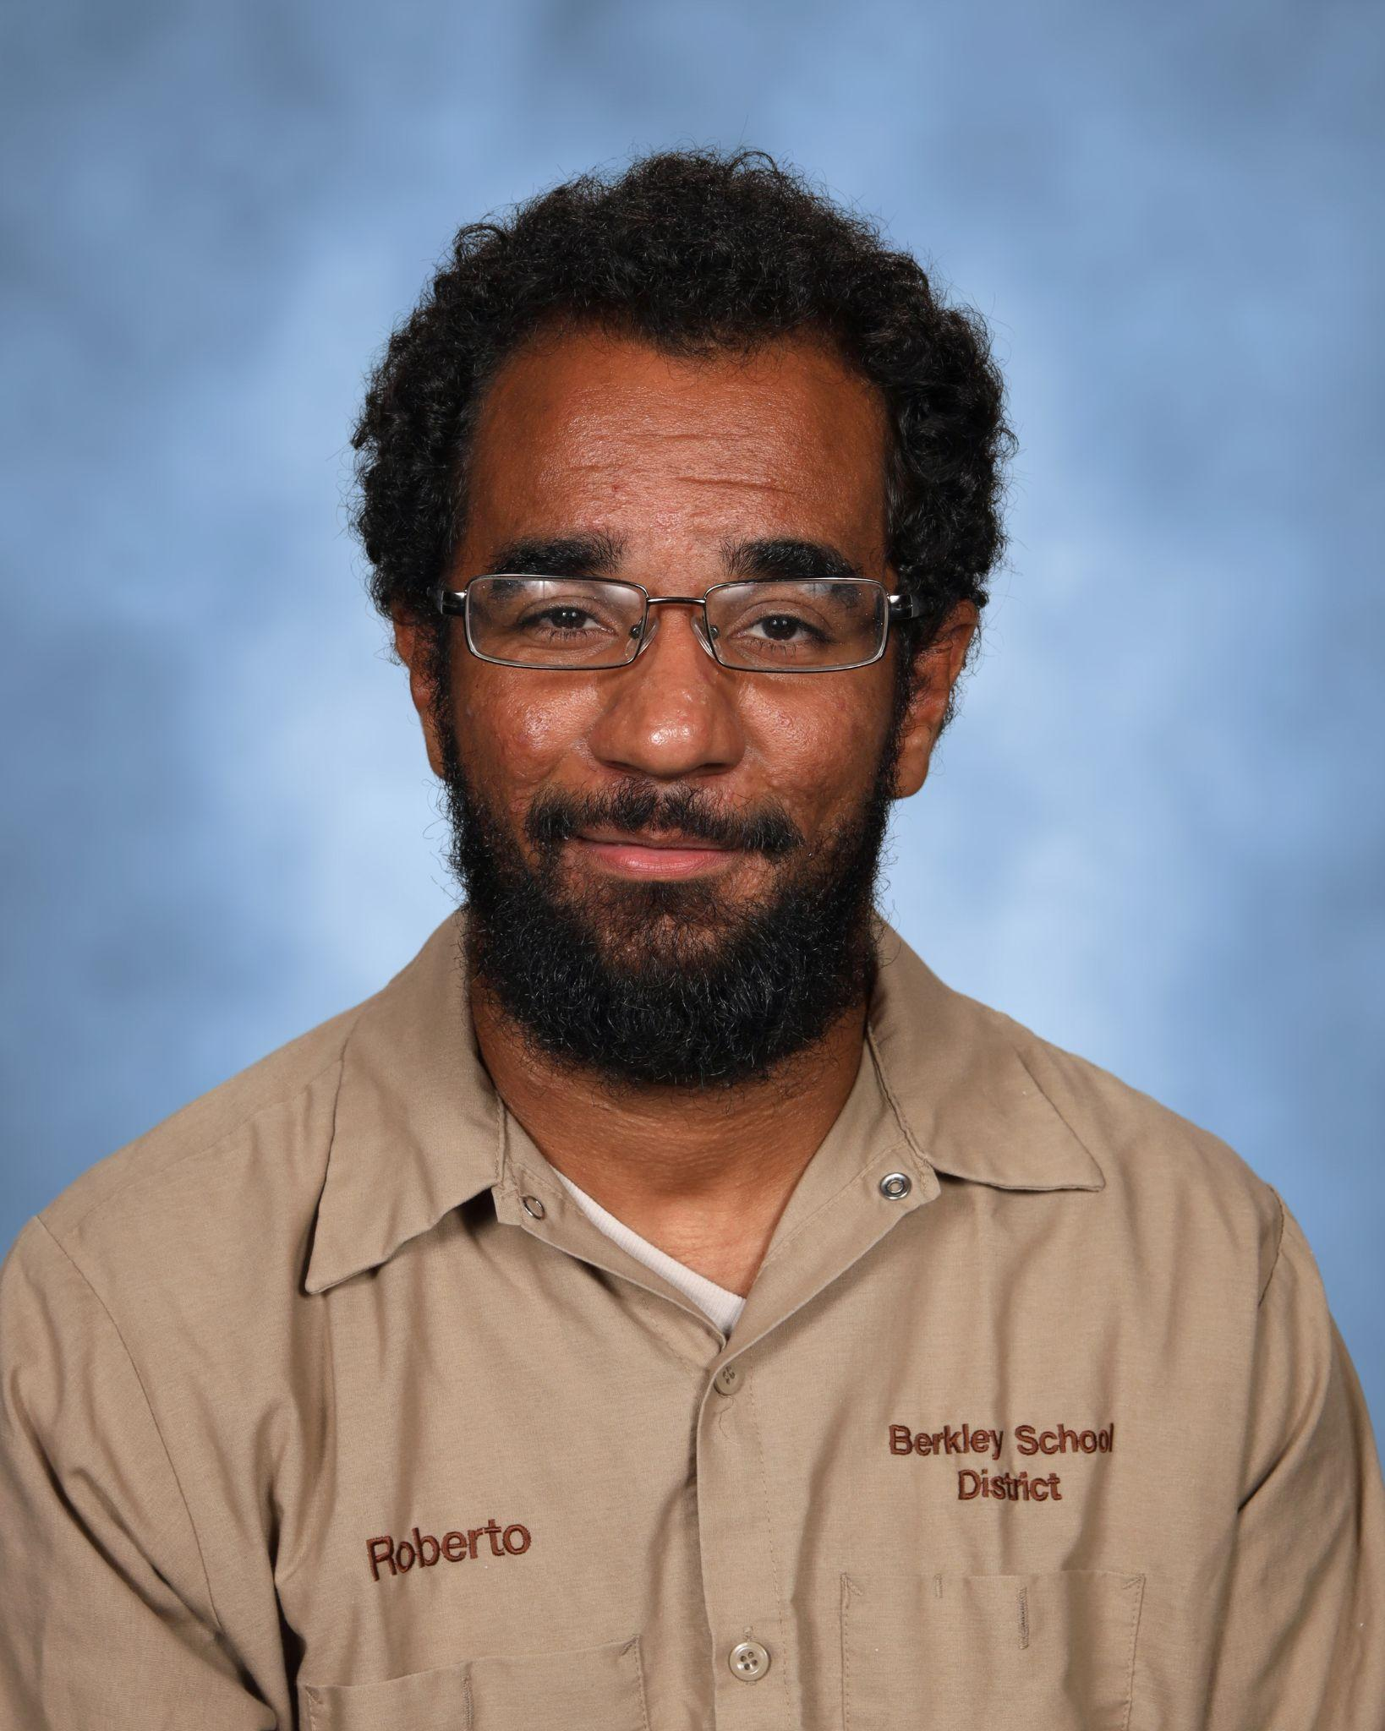
Mr Roberto Fournier - Head Custodian

Slide 7
Our Programs
Before and after school care
is available, as space allows:
Angell, Pattengill, Rogers and Norup - Berkley Schools Kids' Zone Latchkey Program
Burton - Huntington Woods Recreation Center
Kindergarten
All Schools
Transitional Kindergarten
Location(s) TBD
Full day of learning,
special classes, recess, lunch

Slide 8
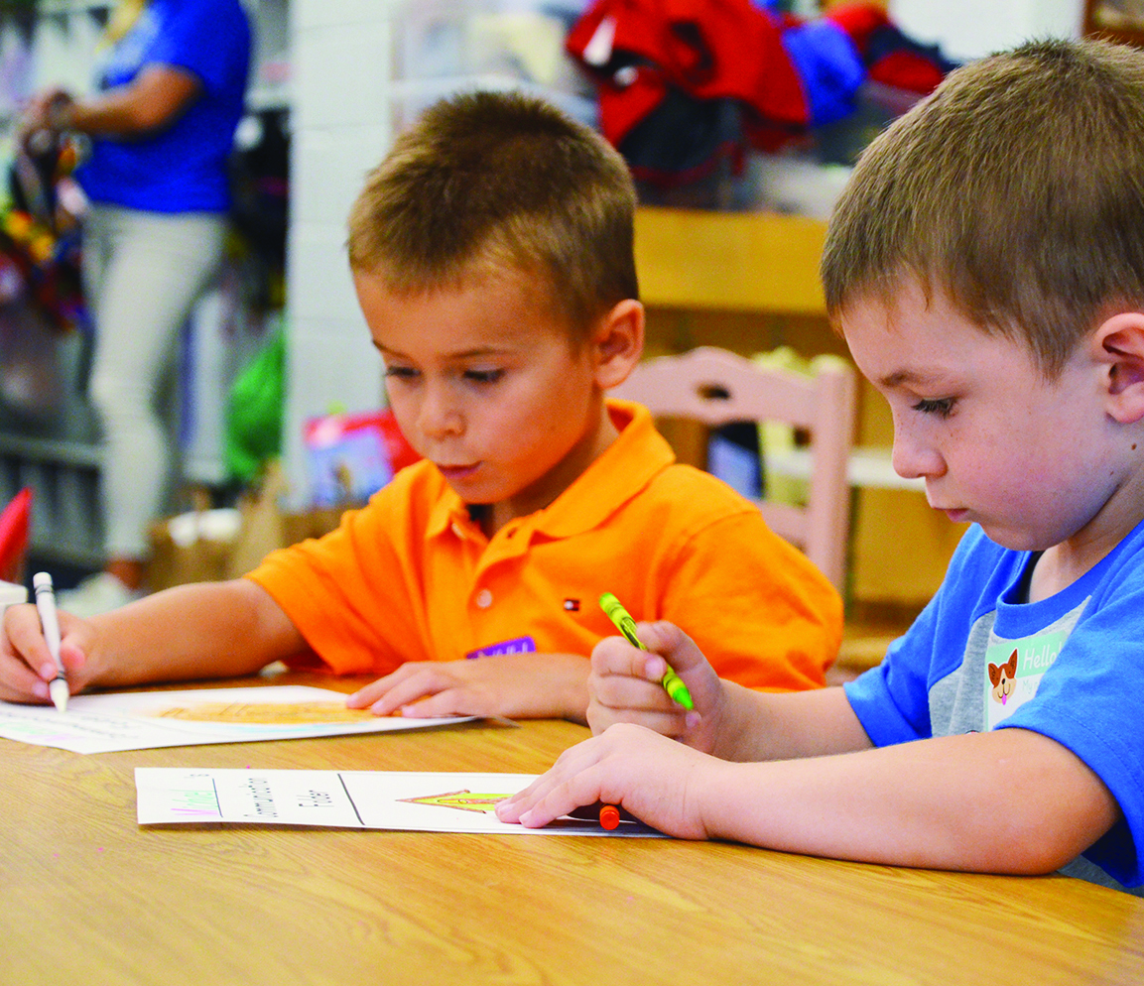
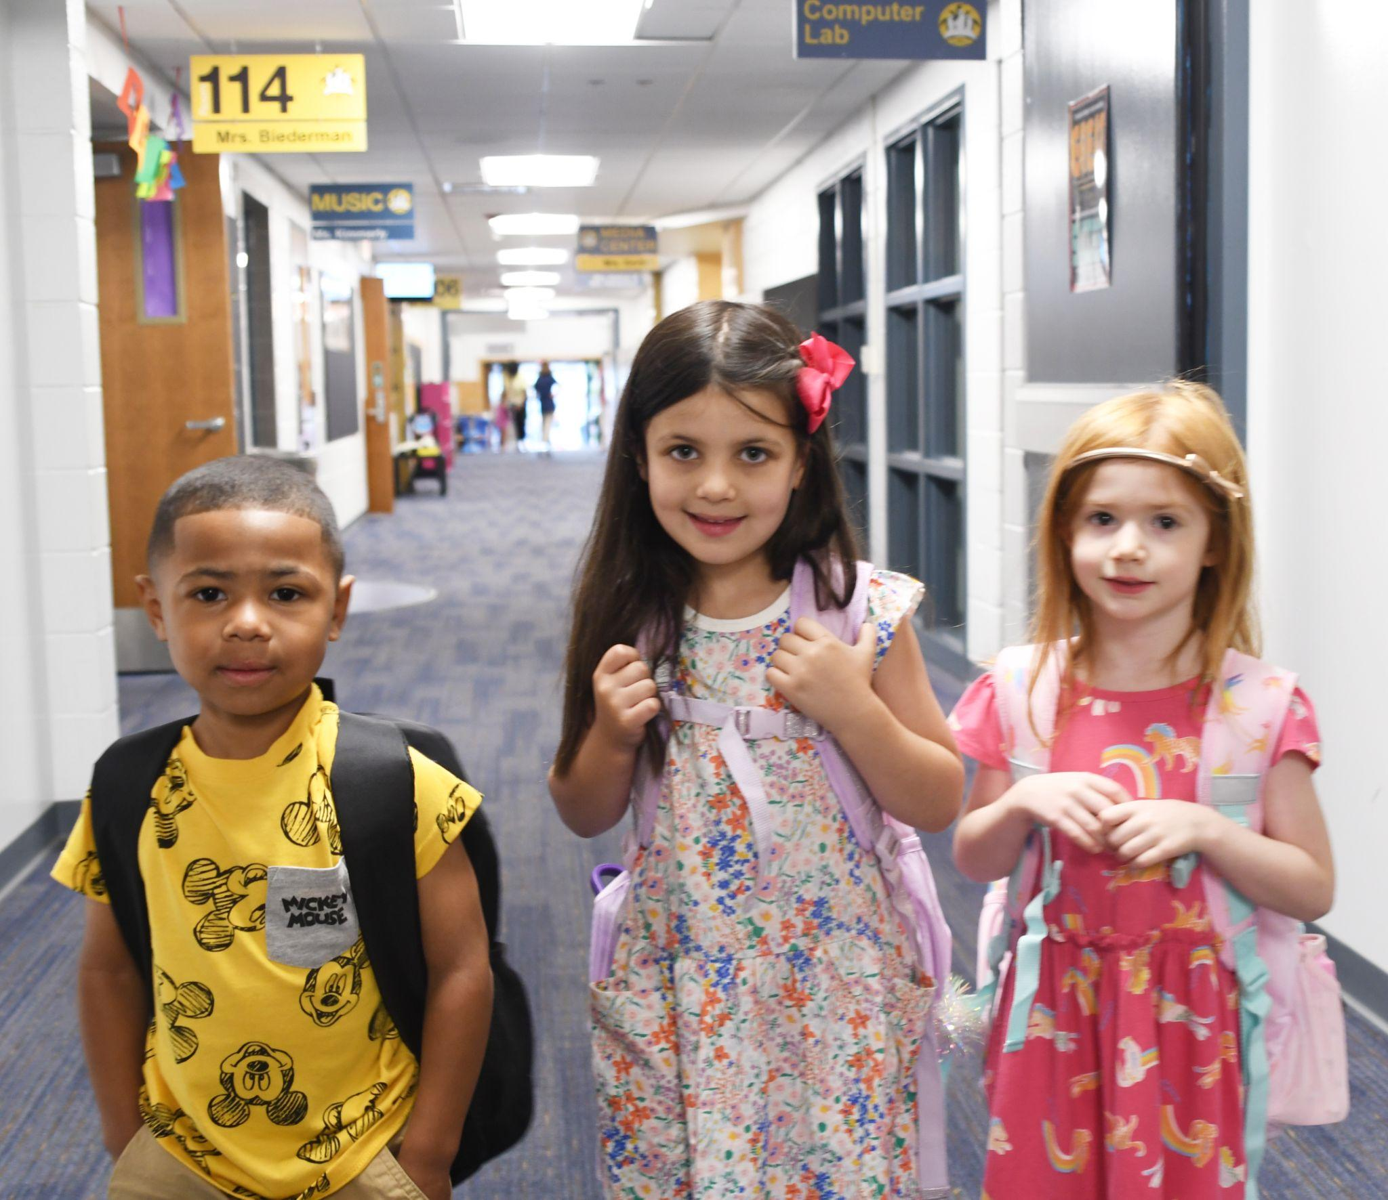
Academics
Reading Literacy and Writing
Math
Science
Social Studies
Special Subjects
Art
Music
Physical Education
Media Center (Library/Technology)
Optional: Study Skills & Spanish

Slide 9
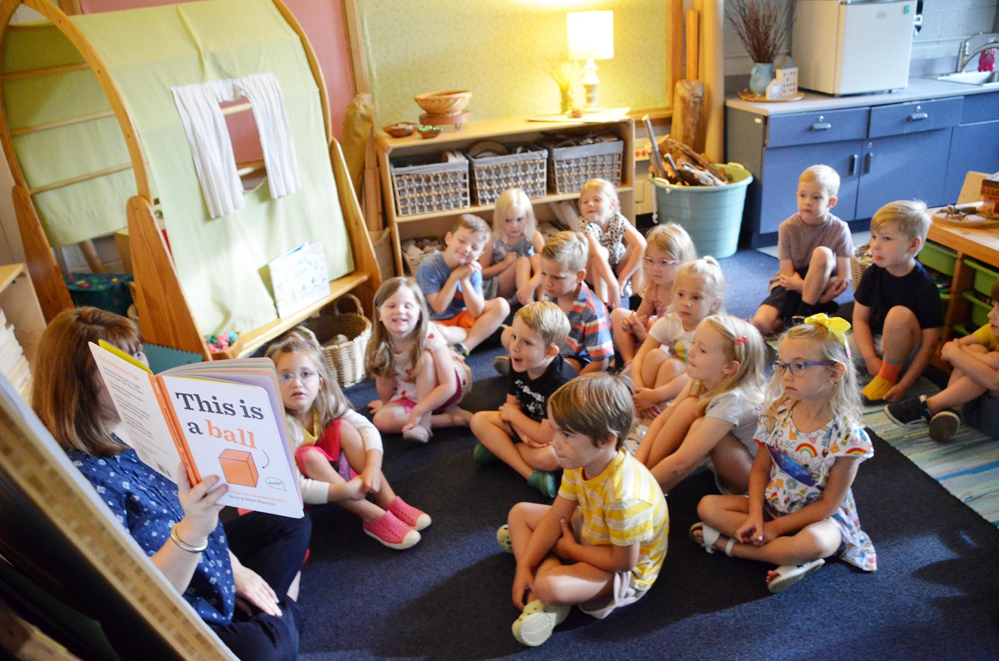
What is the Transitional Kindergarten program?
Specialized program to meet the academic and social development of students who are not quite ready for regular Kindergarten
Placement is a joint decision between parents and principals;
A guided discussion will include:
  readiness skills
  stamina/attention span
  preschool experience
  academic skills
  birthdate
  level of independence

Slide 10
If you are considering Transitional Kindergarten, your child should be attempting to…..
Dress themselves, zip their coat, and tie their shoes
Use the bathroom independently
Take turns and share
Keep hands to themselves
Sit quietly to listen to a short story

Slide 11
If you are considering Kindergarten, your child should be attempting to…..
Dress themselves, zip their coat, tie their shoes
Use the bathroom independently
Take turns and share
Keep hands to him/herself
Sit quietly to listen to a short story
Use a pencil
Separate from parents without becoming upset
Say their first and last name
Write their first name
Draw some form of a person
Count to 10 and recognize numbers to 5
Recognize colors and shapes
Recognize upper and lower case letters
Color, cut, and glue appropriately
Can rhyme and has some exposure to letter sounds

Slide 12
Does my child qualify for Transitional Kindergarten & Kindergarten?
Must be 5 years old by September 1, 2023
Transitional Kindergarten may not be available in all buildings. Locations are determined on District-wide needs after enrollment window has closed.
  If a TK program is held in the child's home/neighborhood school, and there is more interest than space, a lottery will take place for TK placement.
  Students will return to their home/neighborhood school for Kindergarten if they do not attend TK in their neighborhood school.
What is a waiver? Why would I need one?
  If I sign a waiver, I am saying my child is ready for Kindergarten.

Slide 13
Registration is Online!
For Berkley School District Residents
  Enrollment Window – February 6-17
  www.berkleyschools.org/enrollment
  Enrollment takes place all online, including uploading required documents
  A school summary for your preschool will be coming after registration is completed.

Slide 14
Schools of Choice Program
(Non-residents)
Transitional Kindergarten through 5th grade – based on space availability
Open to all Berkley Schools elementary schools
Oakland County resident
Application Window:
February 13 - March 3, 2023
Berkley is a walking district; Transportation not provided
Building preference is not guaranteed
SOC students remain in BSD through graduation
  Unless there is a break in enrollment
Notes:
‹#›

Slide 15
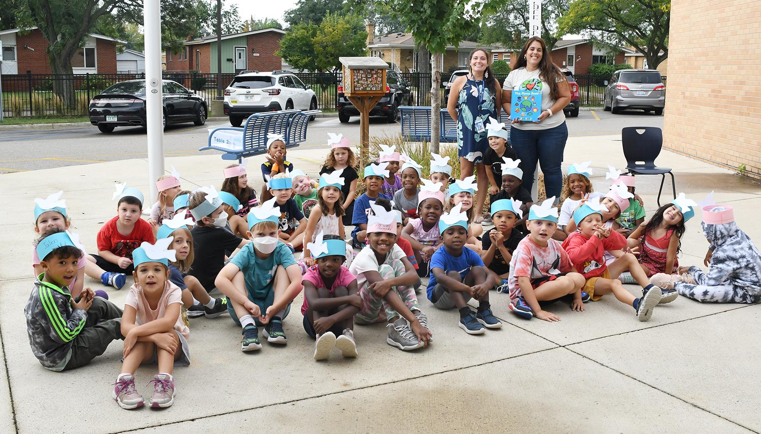
Transitional Kindergarten & Kindergarten Round-Up Dates
Angell – Wednesday, May 10, 2023
Burton – Friday, May 5, 2023
Norup International – Tuesday, May 16, 2023
Pattengill – Wednesday, May 10, 2023
Rogers – Tuesday, May 16, 2023

Slide 16
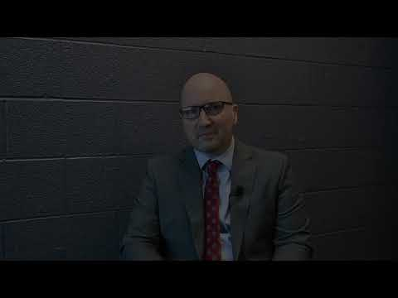
Watch this video welcoming you to the Berkley Schools from
Superintendent Scott Francis and learn more about the enrollment process.

Slide 17
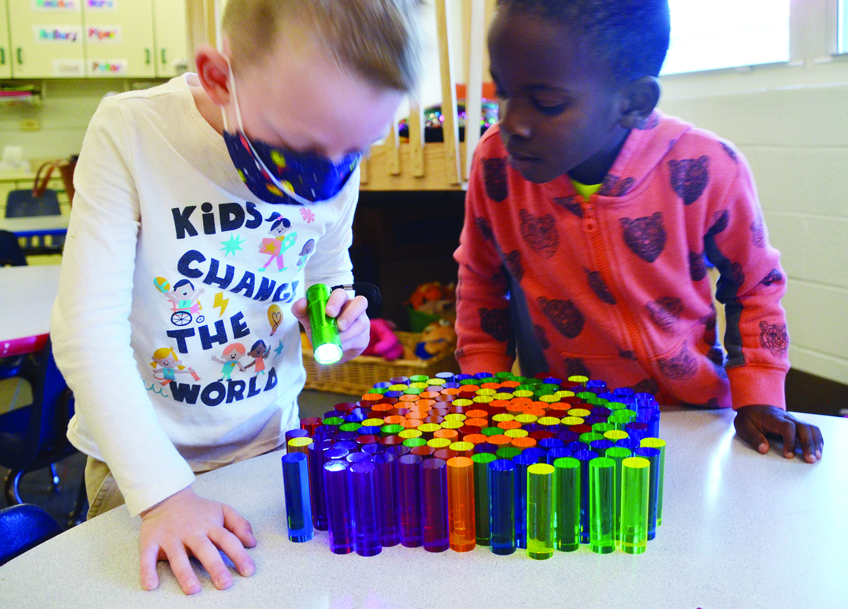
Questions?
Thank you for attending!
Don’t forget to sign in and
let us know what your
preference is for next year.

