Slide 1
Transitional Kindergarten & Kindergarten Parent Information Night
2022
Notes:
1

Slide 2
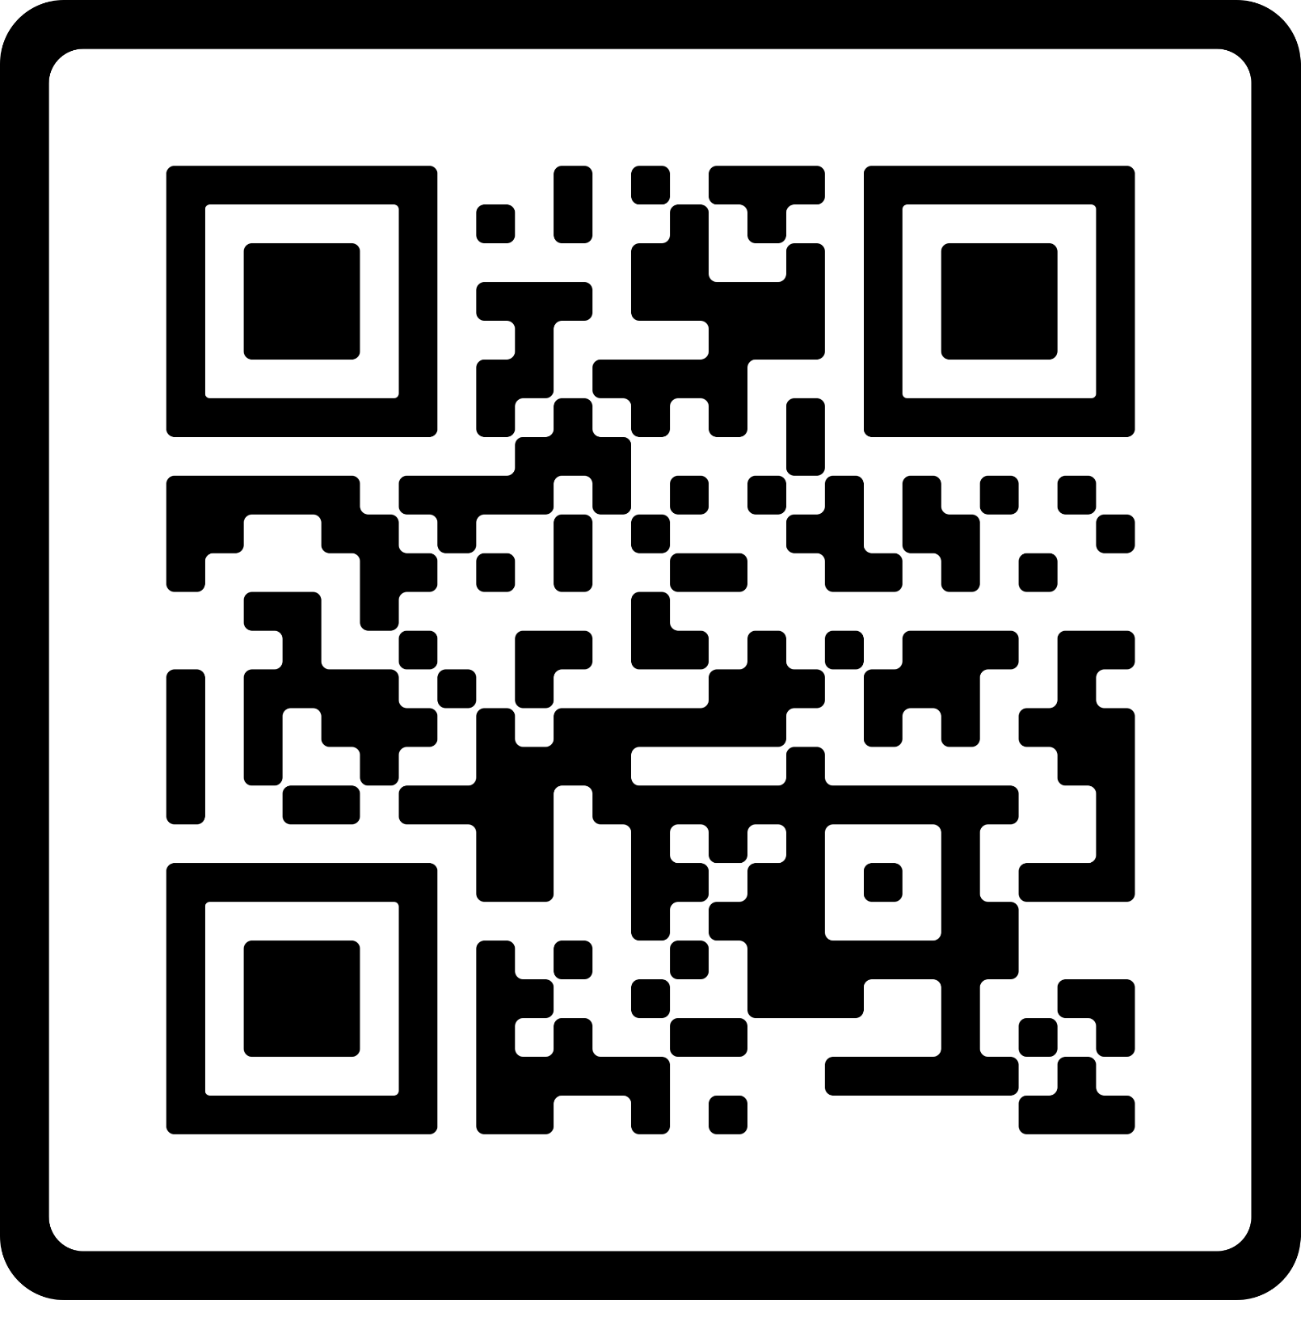
Tonight’s Agenda
Welcome-please fill out the attendance sheet
Information from the PowerPoint
Questions
Tour of the building
School staff available for questions

Slide 3
Principal’s Welcome
We are so pleased you will be joining us for the fall of 2022.
Our school is a warm and inviting place to learn and grow.

Slide 4
Our Programs
Kindergarten – All Schools
Transitional Kindergarten – Location(s) TBD
Full day of curriculum, special classes, recess, lunch
_____________________________________________
Before and after school care is available
Angell, Pattengill, Rogers and Norup - Berkley Schools Kids' Zone Latchkey Program
Burton - Huntington Woods Recreation Center

Slide 5
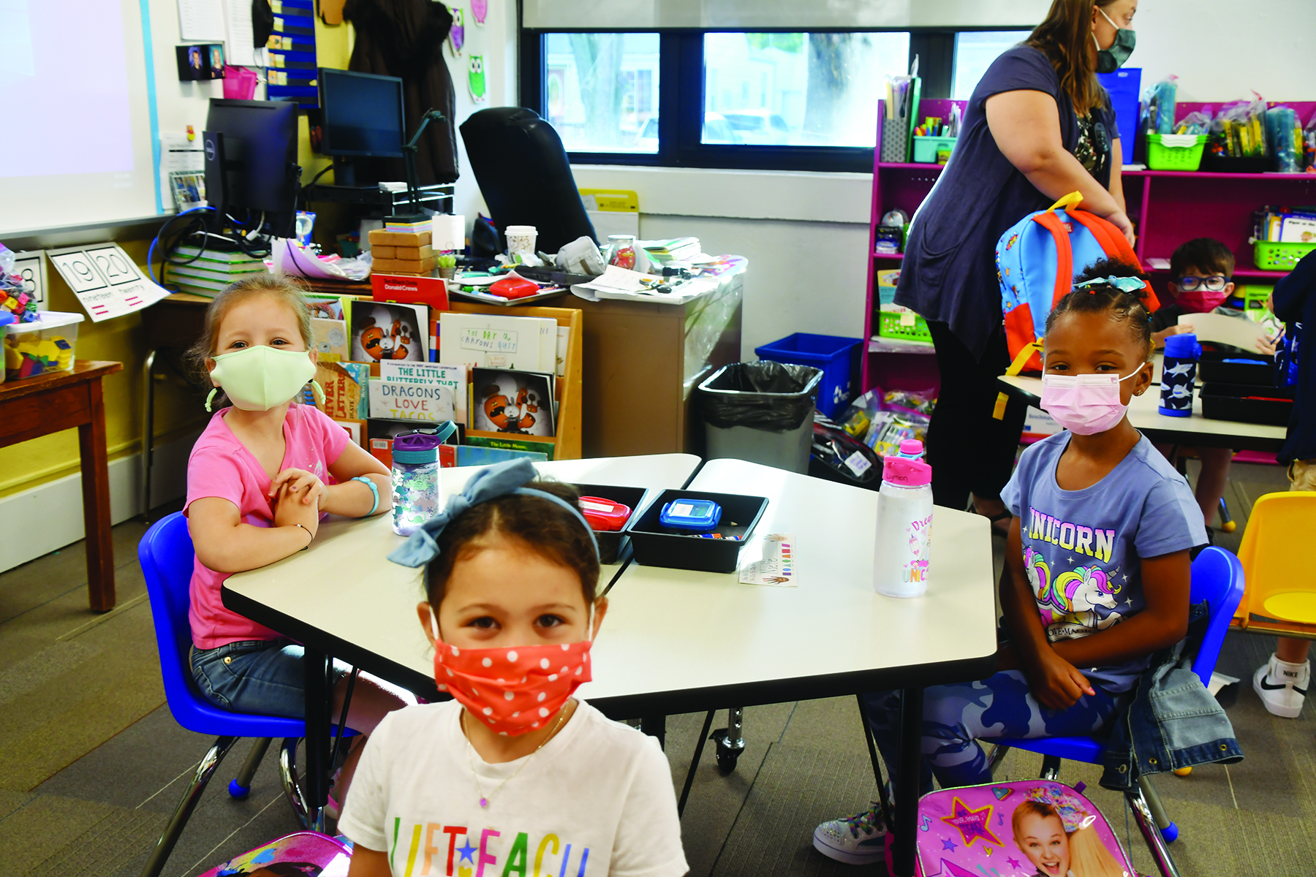
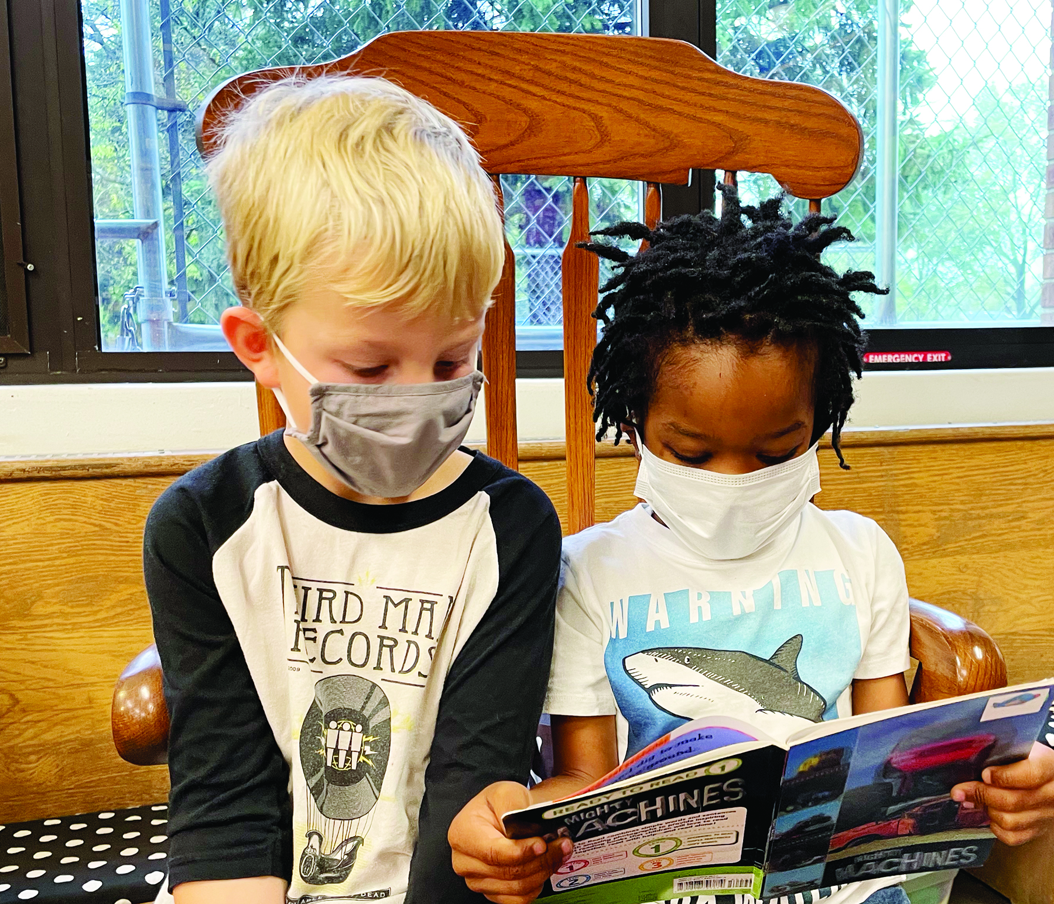
Academics
Reading Literacy and Writing
Math
Science
Social Studies
Special Subjects
Art
Music
Physical Education
Media Center (Library/Technology)

Slide 6
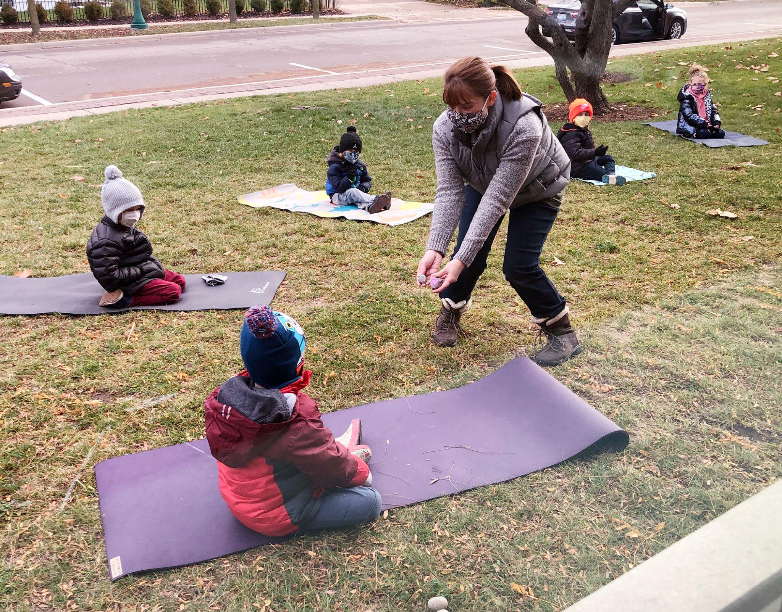
What is the Transitional Kindergarten program?
Specialized program to meet the academic and social development of students who are not quite ready for regular Kindergarten
Placement is a joint decision between parents and principals; A guided discussion will include:
readiness skills
stamina/attention span
preschool experience
academic skills
birthdate
level of independence

Slide 7
If you are considering Transitional Kindergarten, your child should be attempting to…..
Dress themselves, zip their coat, and tie their shoes
Use the bathroom independently
Take turns and share
Keep hands to him/herself
Sit quietly to listen to a short story

Slide 8
If you are considering Kindergarten, your child should be able to…..
Dress themselves, zip their coat, and tie their shoes
Use the bathroom independently
Take turns and share
Keep hands to him/herself
Sit quietly to listen to a short story
Use a pencil
Separate from parents without becoming upset
Say their first and last name
Write their first name
Draw some form of a person
Count to 10 and recognize numbers to 5
Recognize colors and shapes
Recognize upper and lower case letters
Color, cut, and glue appropriately
Can rhyme and has some exposure to letter sounds

Slide 9
Does my child qualify for Transitional Kindergarten and Kindergarten?
Must be 5 years old by September 1, 2022
Locations for Transitional Kindergarten programs are based on district-wide needs; notification by Spring 2022
What is a waiver? Why would I need one?
If I sign a waiver I am saying my child is ready for kindergarten.

Slide 10
Registration is Online!
For Berkley School District Residents:
Enrollment Window – February 14-25
www.berkleyschools.org/enrollment
Enrollment takes place all online, including uploading required documents
A school summary for your preschool will be coming after registration is completed.

Slide 11
Schools of Choice Program (Non-residents)
Kindergarten through 5th grade – based on space availability
Oakland County resident
Application Window: February 14 - March 4, 2022
Berkley is a walking district; Transportation not provided
Building preference is not guaranteed
SOC students remain in BSD through graduation!
Unless there is a break in enrollment
Notes:
11

Slide 12
Kindergarten Round-Up Dates
Angell – Thursday, May 5, 2022
Burton – Thursday, May 12, 2022
Norup International – Monday, May 9, 2022
Pattengill – Wednesday, May 11, 2022
Rogers – Tuesday, May 10, 2022

Slide 13
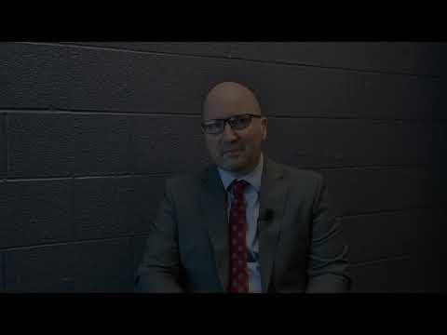
Watch this video welcoming you to the Berkley Schools from Superintendent Scott Francis and learn more about the enrollment process.

Slide 14
Thank you for attending!
Questions?

