Slide 1

Virtual Round Up for
TK and K
2021-2022
Burton Elementary

Slide 2
Welcome to 2021-2022 School Year
The information included in this powerpoint is subject to change due to changing regulations
from the CDC and
the State of Michigan.

Slide 3
Burton Elementary
We are hoping to have 2 Transitional Kindergarten Classrooms
We will have 4 Kindergarten Classrooms
We will arrange something special in August before school begins for students and parents to have an intimate meet and greet with the teacher in the classroom.
Our students will also have Art taught by Mrs. Jakuc, PE taught by Mr. Transit, Media/Library taught by Mrs. Smith, and Music taught by Mrs. Manuel.

Slide 4
Class Placement
Who is my teacher?
You will receive your child’s placement the week of August 9, 2021. The teachers will reach out to you with a welcome note to your child and a signup genius for the meet and greet. All of our TK and Kindergarten teachers work closely and share many activities.
We are one big happy family!
It may be necessary to adjust your child’s class assignment as we get to know the individual strengths and needs of your child. We normally hear from the preschool teachers and sometimes visit preschools to see your children in action in their preschool environment. We were unable to follow our typical protocol this year.

Slide 5
A Typical day in the life at Burton
We will keep you informed if anything changes
Students will arrive at their designated doors and wait for their teacher to come and collect them. Parents should say goodbye at the door and not enter the building (new regulations from CDC). The teachers and helpers will make sure everyone gets to their classroom and assist in unpacking. Each child will have a locker to themselves with the exception of twins sharing a locker. The teachers will show them how to open the locker (no combination locks until Middle School) and how to hang up their belongings. They will then enter the classroom to begin the day.
Here is a sample of a typical day:
Morning Meeting and announcements, Pledge of Allegiance, lunch count for purchasing lunch.
Carpet time - welcoming the group, calendar time, read alouds, discussion of day’s events and expectations
Morning work time, break, special (art, music, PE or media)
Lunch in the classroom (new regulations) 12:00-12:45
Physical Break/activity- outdoors if the weather permits
Rest time- on mats in the classroom to rest their minds and bodies
Afternoon work time - and possibly a special class
Continuation of work time - pack up and dismissal
Miss Posey and Mrs.Jakab doors- Plaza by the clock called the Plaza doors
Mrs. Martin and Mrs. Fox doors- by the tubes on the playground called the Tube doors
Mrs. Chmiel door- the back doors by the track called the Fifth grade doors.

Slide 6
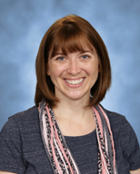
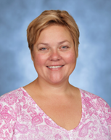
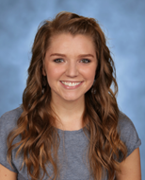
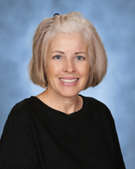
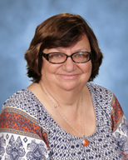
Meet The TK and K Teachers
Miss Posey, Mrs. Martin, Mrs Chmiel,
Mrs.Fox and Mrs. Jakab with an additional K teacher TBD

Slide 7
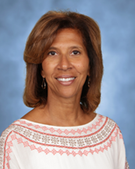
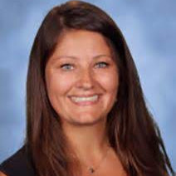
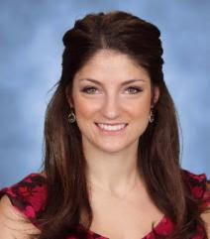
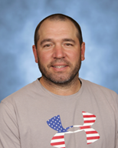
Meet the Specialists
Music, Media, Art and PE
Mrs. Manuel, Mrs. Smith, Mrs.Jakuc and Mr. Transit

Slide 8
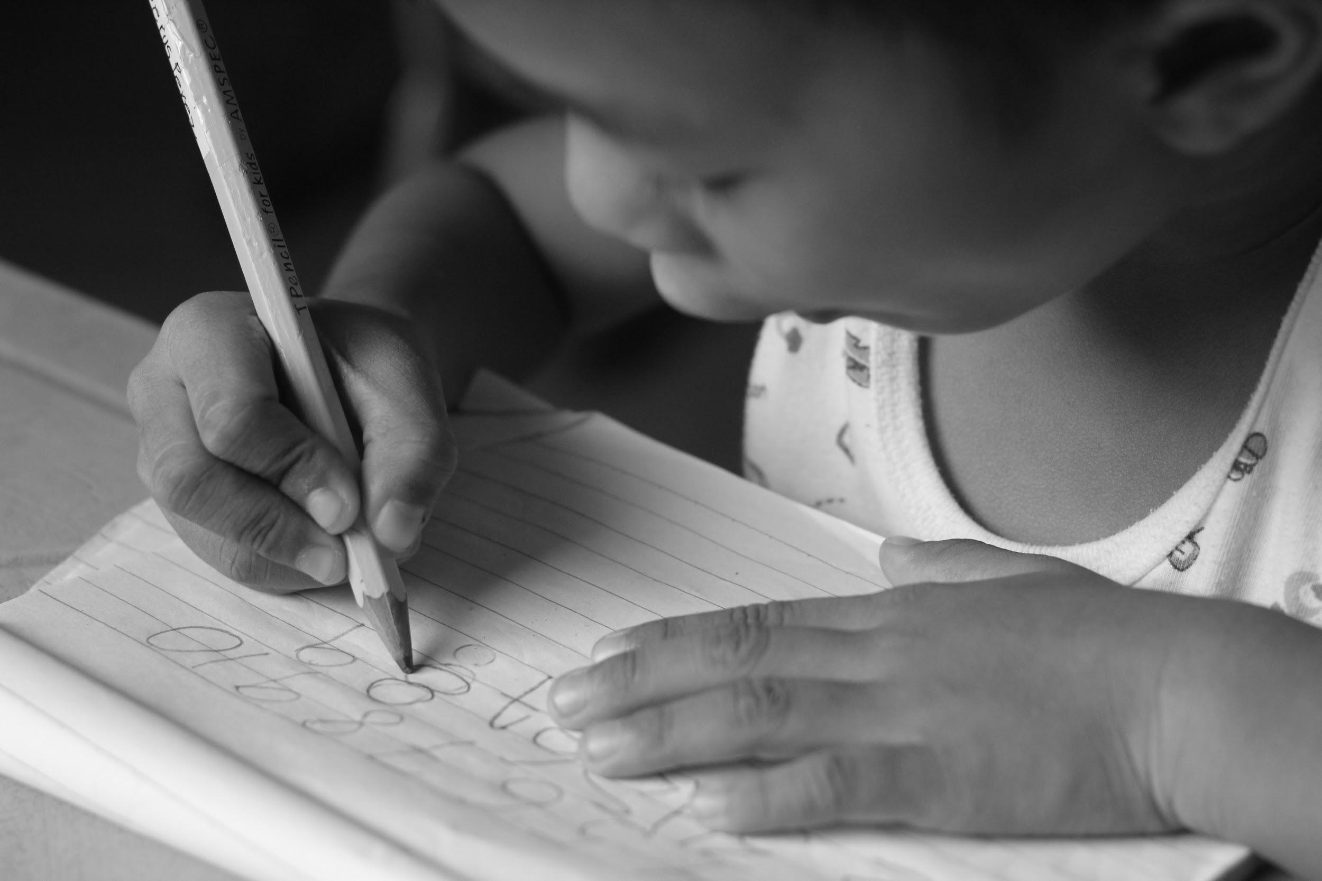
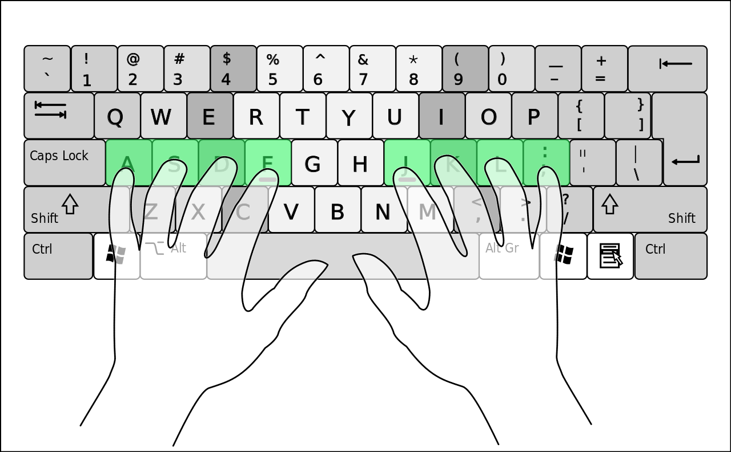
Handwriting & Keyboarding
TK and K students will also learn about handwriting and keyboarding. We use a program called Learning without Tears. This covers both the correct formation of letters and dynamics of using the Keyboard.

Slide 9



COMMUNICATION
Parent communication is very important to us. We use a team approach between home and school. Teachers will send emails, contact you by phone or see you at dismissal. You are always welcome to contact teachers through voicemail or email. Please remember that during the day the teachers are teaching and cannot return calls or emails until the end of the day. They need to give your children all of their attention during the day.

Slide 10

LUNCH AT BURTON
We will begin the year by having lunch in the classroom and hopefully move into the gym/cafe as the restrictions change. This summer, please practice at home with a lunch box and lunch items. Your child will feel much more confident if they can open everything themselves. Be mindful of the containers you use. We are a Nut Sensitive building, so please read all labels carefully, no nut products or items from a facility that also processes any kind of nuts.
Thank you.

Slide 11

First Day of School
We begin the year on Monday, August 30, 2021. Both August 30 and August 31 will be half days of school for TK and K only. Dismissal for those days will be at 11:20 am. The afternoons of these days will be used for assessments by appointment. At that time, the teachers will be meeting with the children in small groups to assess their beginning skills. The Speech Pathologist and Occupational Therapist will also play some games with the children to assess their skills.

Slide 12

Childcare
The HW Rec Center provides before school care and also after school latchkey. Their space is limited and fills up quickly. Burton is the backup, and if needed, will offer an after school latch key called Kids Zone that will accommodate students until 6:00 pm. There is minimal difference between the programs. During vacations and weeks we are not in school the HW Latchkey provides outings. On snow days and days we are not in school our Burton Kids Zone will combine with other district latchkeys at the Avery Center in north Oak Park.

Slide 13
Curriculum Nights
In person/virtual
We are hoping to have in person curriculum nights in August. The TK night is Tuesday, August 24th at 6:30 pm. The Kindergarten Night will be on Wednesday, August 25th at 6:30 pm. If we are unable to meet in the classrooms the teachers will present their information in a virtual platform.

Slide 14

Picture day
Our picture day will be on
Wednesday,September 1, 2021
At this time your child’s lunch card/library card will be made as well as school photos.

Slide 15

Allergies
If your child has any allergies that require an EpiPen or medical attention please contact the Burton Office for medical forms and/or more information about our procedures. Burton is a Nut Sensitive building. No food items brought into the building can contain nuts or manufactured in a facility that may have traces of nuts.

Slide 16
Links for information needed for the
first day of school
Vision: Michigan Law (Public Health Code, Act 368, and Michigan School
Code, Act 291) requires a vision screening for kindergarten entrance.
Vision screening done in preschool, by a health department technician or doctor’s office.
Oakland County Health Division offers free vision screening for
County residents. More information can be found here: https://www.oakgov.com/health/services/Pages/Vision-Testing.aspx
Immunizations: Children need to be up to date on immunizations prior to the first day of school. You can find the list of recommended vaccines located on Oakland County's Website here: https://www.oakgov.com/health/services/disease-prevention/immunizations/Pages/cost-schedule.aspx
Waivers: If your child is unable to receive a vaccination you will need to provide a waiver. More information can be found here: https://www.oakgov.com/health/services/disease-prevention/immunizations/Pages/rule-change.aspx

Slide 17
Who to contact for questions?
On May 5, 2021 Ms. Krehbiel will offer an evening Zoom meeting to answer any questions parents may have. Here is the Zoom link for May 5, 2021 at 7:00 pm.
https://us02web.zoom.us/j/82049081726?pwd=WEsyR2RLOC9maUMxU3JvM3lLSVZvZz09
She can always be reached at the information below
Maribeth Krehbiel
Maribeth.Krehbiel@berkleyschools.org
234-837-8600

