Slide 1
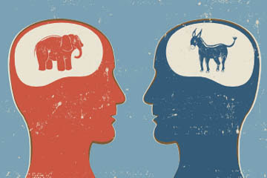
Notes - Political Ideology

Slide 2
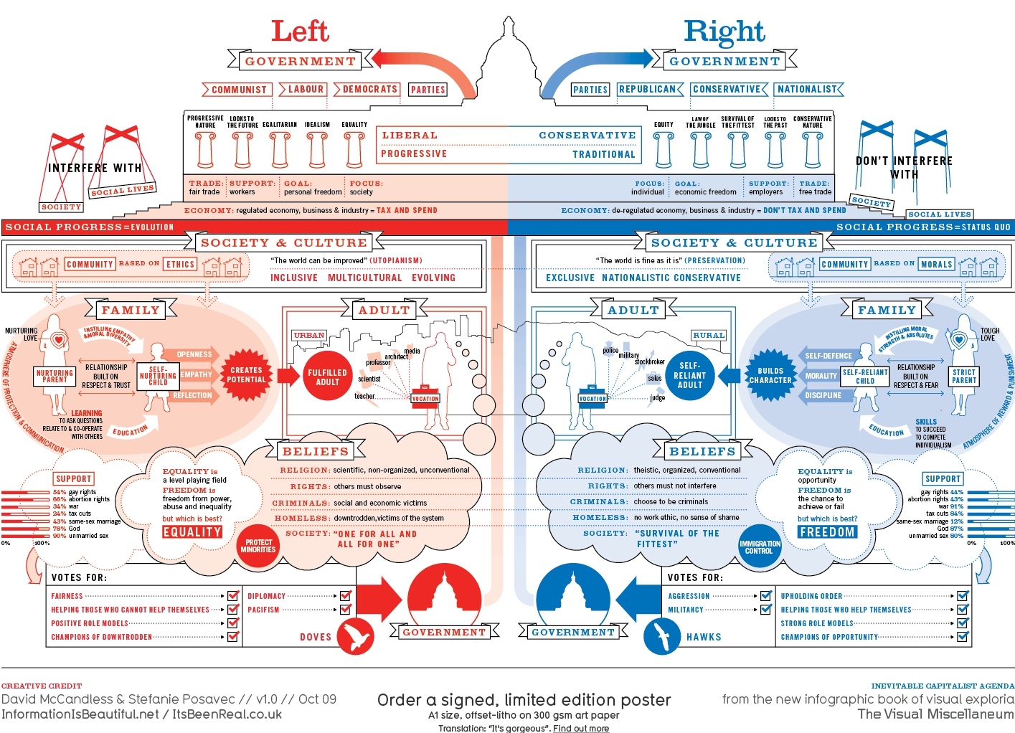

Slide 3
Notes - Political Ideology Understanding political Ideologies economically (Economic Self-Governor)
1 | Far Left = |  |  | Far Right = |  |  | 2
3 |  |  |  |  |  |  | 4
7 |  | 6 | 5 |  | 8 | 9
Left
Right
Liberal (Progressive)
Conservative

Slide 4
Notes - Political Ideology Understanding political Ideologies economically (Economic Self-Governor)
Far Left = Pure Communism: Complete Government ownership and operation of all businesses.
Far Right = Pure Capitalism: Complete Private ownership and operation of all businesses with almost no government regulations.

Slide 5
Notes - Political Ideology Understanding political Ideologies economically (Economic Self-Governor)
1 | Far Left = |  |  | Far Right = |  |  | 2
3 |  |  |  |  |  |  | 4
7 |  | 6 | 5 |  | 8 | 9
5. "Independents" / Moderates / Centrists
Democrats
Socialists
Republicans
Libertarians (right economically, left socially)

Slide 6
They favor…
1 | 2 |  | 3 | 4
…government regulation or control of the economy.
5 |  | 6
Much
Some
Little
Zero

Slide 7
They favor…
1 | 2 |  | 3 | 4
…government regulation or control of the economy.
5 |  | 6
5. They believe LESS in pure capitalism (free market capitalism, the free market economy, the market economy). They are less laissez-faire (French for "Let it be“
6. They believe MORE in pure capitalism (free market capitalism, the free market economy, the market economy)They are more laissez-faire (French for "Let it be")

Slide 8
Notes - Political Ideology Understanding political Ideologies economically (Economic Self-Governor)
Note - Libertarians have low economic and personal self-governor scores because they believe in as little government involvement as possible across the board.
Libertarians believe that the government's only appropriate roles are to keep us safe, and to protect private property and individual liberty.

Slide 9
The Views of our two major parties, Republicans and Democrats (Very broadly speaking!)
Lets do Republicans (and Libertarians) First (Bottom RIGHT box)
Capitalism:
1. Efficiently organizes the economy to provide consumers with what they want. Government rules and regulations only make the process less efficient.
2. Creates tremendous wealth for all of society. We all win.
3. Is usually fair.
A. Talented hard working people will earn more.
B. Lazy people will earn less, as it should be.

Slide 10
The Views of our two major parties, Republicans and Democrats (Very broadly speaking!)
John Stossel’s Greed
http://www.youtube.com/watch?v=EGkEziYbcJo

Slide 11
The Views of our two major parties, Republicans and Democrats (Very broadly speaking!)
Now Democrats (Bottom Left Box)
Capitalism:
1. Organizes a nation’s economy well, but without government regulations, business interests can be harmful to the public interest.
2. Creates tremendous wealth though too much of it goes to those at the top.
3. Is often unfair. Many hard-working talented people through no fault of their own are underpaid, overworked, or unemployed altogether.

Slide 12
The Views of our two major parties, Republicans and Democrats (Very broadly speaking!)
Upton Sinclair’s (a socialist) the Jungle (United Streaming – World History: The Modern Era, Segment 3: Early Industrial America
http://app.discoveryeducation.com/core:player/view/assetGuid/D3257257-307E-4576-AC2D-7C04F606F870

Slide 13
Where they stand on the issues Democrats/Liberals Republicans/Conservatives are more likely to favor… Economic Issues
Cutting Government Spending
Republicans
Pollution Regulations
Democrats
Raising the CAFE Standards (Corporate Average Fuel Efficiency)
Democrats
Tax Cuts to kill a recession
Republicans

Slide 14
Where they stand on the issues Democrats/Liberals Republicans/Conservatives are more likely to favor… Economic Issues
Stimulus spending to kill a recession
Democrats
Privatizing Social Security
Republicans
A single payer healthcare system
Democrats

Slide 15
Where they stand on the issues Democrats/Liberals Republicans/Conservatives are more likely to favor… Economic Issues
College Tuition Grants
Democrats
Lowering the Minimum Wage
Republicans
Union Rights
Democrats

Slide 16
Where they stand on the issues Democrats/Liberals Republicans/Conservatives are more likely to favor… Economic Issues
Libertarianism
Who are the Libertarians with on pretty much all of these economic issues?
Republicans

Slide 17
Understanding political parties on social issues or ethics (Personal Self-Governor)
Dems (& Libertarians) | Republicans
2. | 1.
Let’s start on the right
1. They believe in traditional American (Judeo-Christian) moral values and that the government should actively support them.
2. They believe that morality is a private matter of personal choice that the government should not interfere in.

Slide 18
Where they stand on the issues Democrats/Liberals Republicans/Conservatives are more likely to favor… Moral Issues
Allowing Gay Marriage
Democrats
Pro Choice rather than Pro Life
Democrats
School Prayer
Republicans

Slide 19
Where they stand on the issues Democrats/Liberals Republicans/Conservatives are more likely to favor… Moral Issues
Allowing Desecration of the American Flag
Democrats
Nativity scenes in front of government buildings at Christmas time
Republicans
Intelligent Design Theory in Schools
Republicans

Slide 20
Where they stand on the issues Democrats/Liberals Republicans/Conservatives are more likely to favor… Moral Issues
Libertarianism
Who are the Libertarians with on pretty much all of these social issues?
Democrats

Slide 21
So which ideology are you???!!!

